Slide 1



Vangelis Kritsotakis & Panagiotis Papadakos
Information Systems Laboratory
ICS FORTH

Slide 2
Agenda
First Part
Introduction to Big Data & Spark
Workflow of a spark computation
Focus on RDDs
Second Part
Operations - Transformations & Actions
Shuffle & Performance Tips
Break
Third Part – Components & Code Examples
Core, MLlib, GraphX, SQL, Stream
Discussion

Slide 3
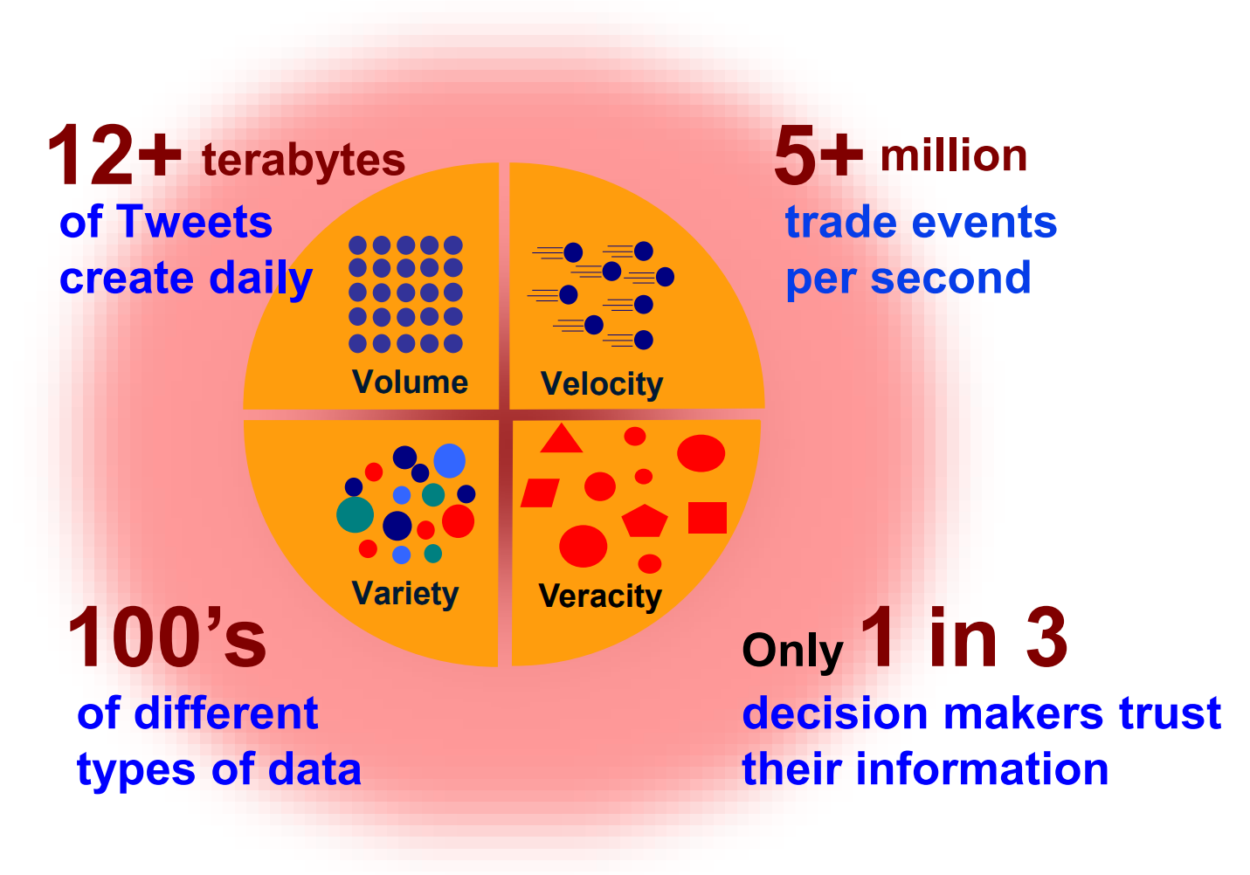
Elusive Definition of Big Data
A lot of competing definitions
The simple core and crucial concept is that data
is too large to fit on a single machine
is too complex that traditional data processing applications are inadequate to cope with them
Challenges include analysis, capture, curation, search, sharing, storage, transfer, visualization, querying, updating, etc.

Slide 4
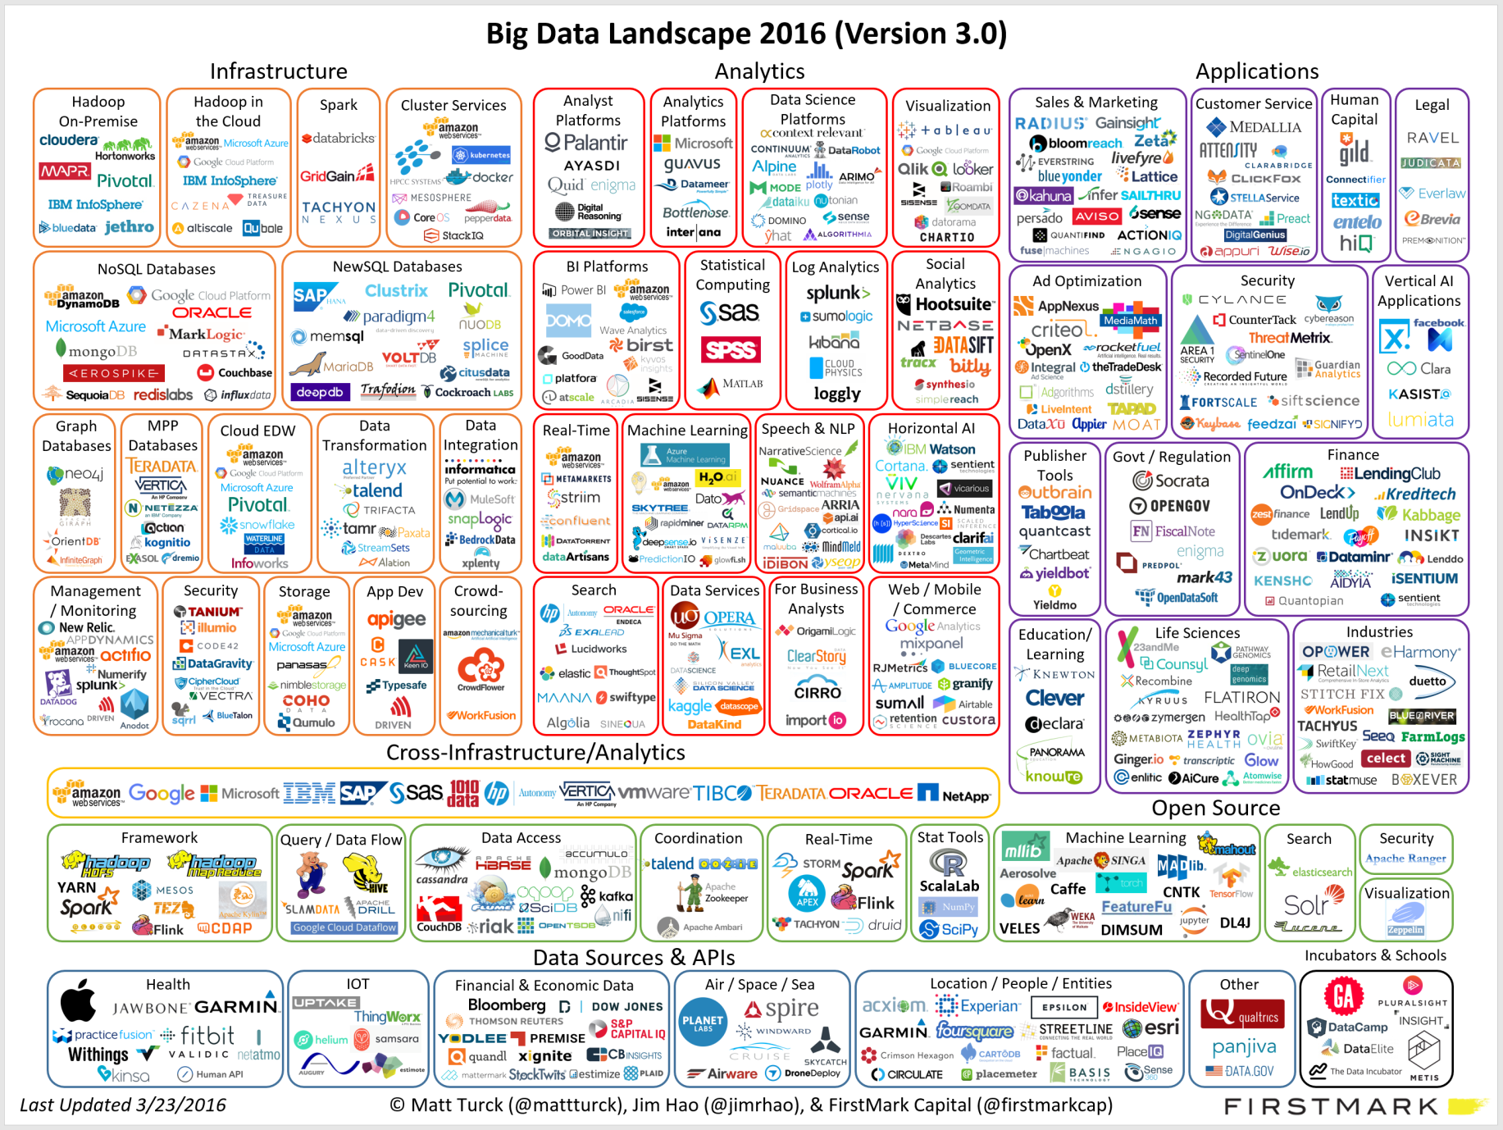
Big Data Landscape

Slide 5
Different Approaches
Batch-based (e.g. Hadoop MapReduce)
one huge computation over a big dataset
slow startup
Real-time streamed data – Storm, Flink
apply computations as real-time data arrive
reduce latency
Micro-Batching (e.g. spark)
apply computations over smaller batches
can also be used over small-batched streamed data
usable for both batched-based and real-time based computations
combine ideas from both worlds

Slide 6
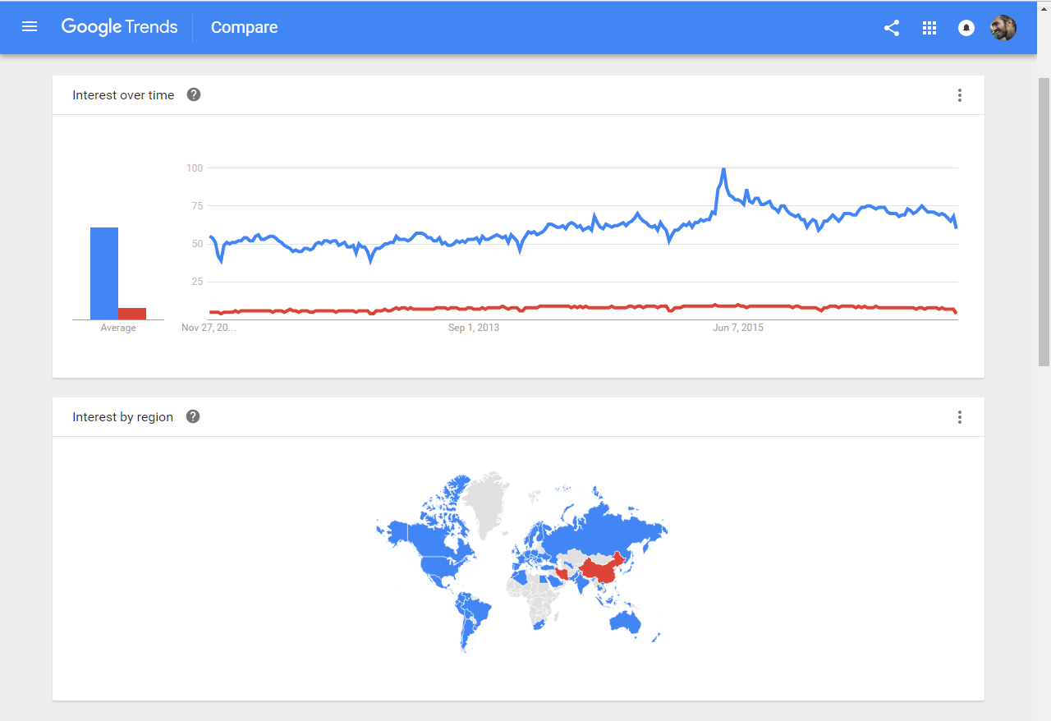
Spark is more popular than Hadoop

Slide 7
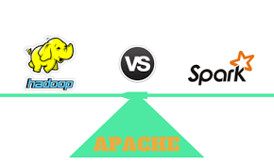
Motivation for spark – A successor of Hadoop MapReduce
Software Engineering
Hadoop code base is huge
Contributions/Extensions are difficult
Java only
System/Framework
Diverse pipeline
Complicated data flow
Slow processing speed
Spark – New Data Abstraction
New fundamental data abstraction that is
… easy to extend with new operators
… allows for a more descriptive computing model

Slide 8
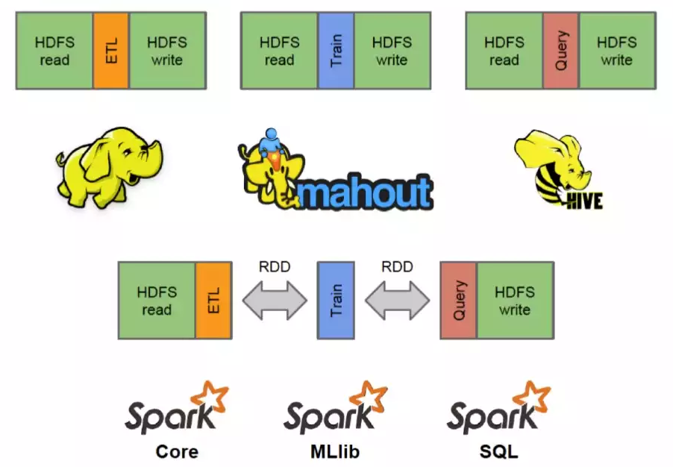
A Simplified Data Flow
Notes:
Diagram from Introduction to Spark Internals

Slide 9

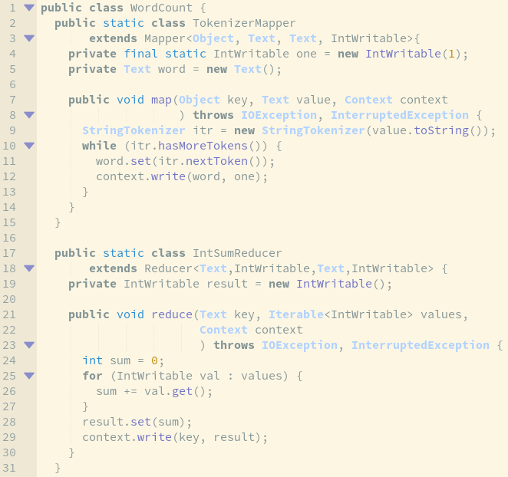
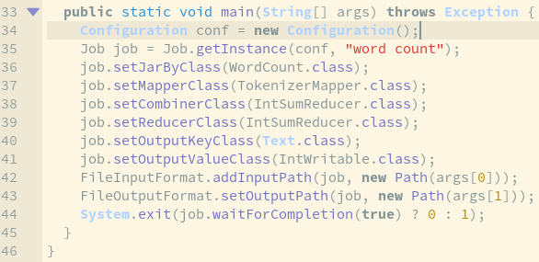
Hadoop - Bloated Computing Model

Slide 10
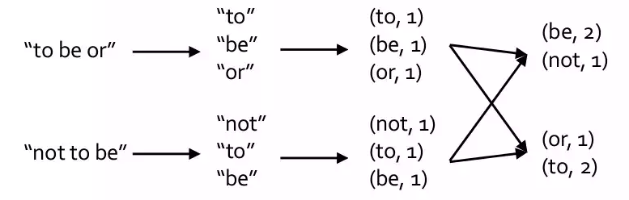
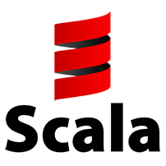
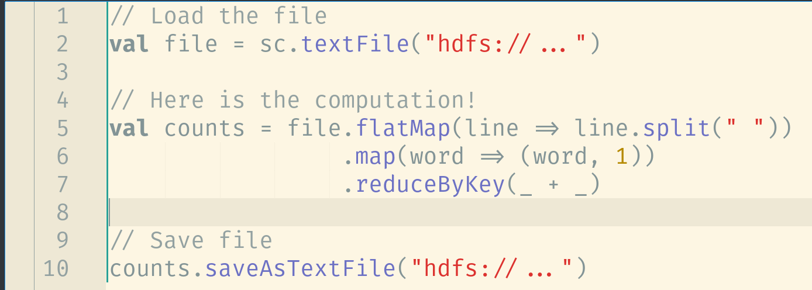
Spark - Descriptive Computing Model
Organize computation into multiple stages in a processing pipeline
Transformations apply user code to distributed data in parallel
Actions assemble final output of an algorithm from distributed data

Slide 11
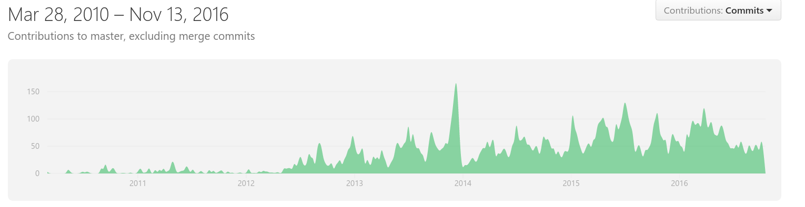
What is Spark
Spark is an open source cluster computing framework
Initially started in 2009 at UC Berkeley’s amplab
Apache Software Foundation 2013
Supported by Databricks
One of the most active and popular apache projects
More than 1000 contributors
Written in Scala

Slide 12
Spark Goals
Generality
Diverse workloads, operators, job sizes
Low Latency
Sub-second
Fault Tolerance
Faults are the norm not the exception
Simplicity
Often comes from generality
Exploit existing technologies
Distributed file systems like HDFS
Cluster managers like Yarn, Mesos

Slide 13
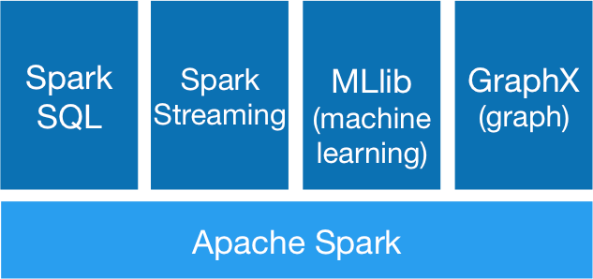
Spark – A Unified Ecosystem
Spark SQL (SQL on Spark)
Spark Streaming (stream processing)
MLlib (machine learning library)
GraphX (graph processing)

Slide 14
Spark Basic Features
A fast and general engine for large-scale data processing
An open-source implementation of Resilient Distributed Datasets (RDD)
Has an advanced DAG execution engine and in-memory computing
Uses the Scala collections functional API for manipulating data at scale

Slide 15
Spark Basic Features
Provides in-memory data caching and reuse across computations
Applies a set of coarse-grained transformations over partitioned data
Failure recovery relies on lineage to re-compute failed tasks
Supports the majority of input formats and integrates with Mesos/Yarn/HDFS

Slide 16
Spark Basic Features
Fast
Run machine learning iterative programs
...up to 100x faster that Hadoop in memory
...or 10x faster on disk
Avoid materializing data on HDFS after each iteration
Easy to use
Fluent Scala/Java/Python/R API
Interactive shell (repl)
2-5x less code (than Hadoop MapReduce)

Slide 17
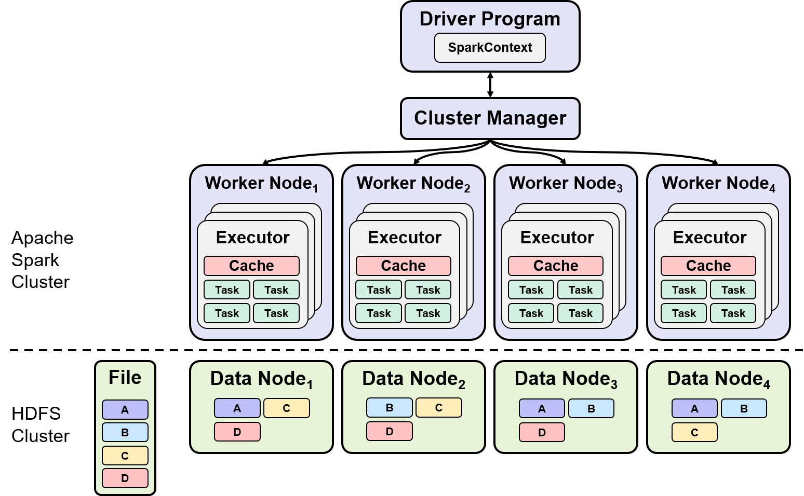
Spark - The Big Picture
Spark Driver
Separate process to execute user application
Creates SparkContext to schedule jobs, execute and negotiate with cluster manager
Executors
Run tasks scheduled by driver
Store computation results in memory, on disk or off-heap
Interact with storage systems
One JVM / executor
One thread / task
Cluster Manager
Mesos, Yarn,
Spark standalone
Data Locality
Avoid network I/O, workers should manage local data
If cached use its locations

Slide 18
Physical Computational Units
Jobs
Individual executed action – top level work item
Composed by a set of tasks arranged in stages
Stages
A wave of work within a job corresponding to one or more pipelined RDDs
Job split based on previous cached action or shuffle
Tasks
A unit of work within a stage corresponding to one RDD partition – The minimum unit of physical execution
Shuffle
Redistribution of data across nodes - The transfer of data between stages
Notes:
Add graphics for notation per concept inpired from the previous slide

Slide 19
Execution workflow
DAG
TaskSet
Task
Driver Program
RDDs
DAGScheduler
Cluster
Manager
Executor
RDD₁
RDD₂
_{P}
_{P}
_{P}
_{P}
_{val conf = new SparkConf()}
val sc = new SparkContext(conf)
…
_{rdd1.join(rdd2)}
_{.filter(...)}
_{Threads}
_{P}
_{P}
_{P}
_{Block Manager}
_{P}
_{P}
_{P}
User defined computations
Build the operator DAG
split graph into stages of tasks
submit each stage as ready
launches tasks via cluster manager
retries failed or struggling tasks
executes tasks
stores and serves blocks
Notes:
The partitions diagram be rotated 90 degrees

Slide 20
Execution workflow
DAG
TaskSet
Task
Driver Program
RDDs
DAGScheduler
Cluster
Manager
Executor
RDD₁
RDD₂
_{P}
_{P}
_{P}
_{P}
_{val conf = new SparkConf()}
val sc = new SparkContext(conf)
…
_{rdd1.join(rdd2)}
_{.filter(...)}
_{Threads}
_{P}
_{P}
_{P}
_{Block Manager}
_{P}
_{P}
_{P}
User defined computations
Notes:
The partitions diagram be rotated 90 degrees

Slide 21
Driver
The Driver is the user defined program
Represents a connection to the computing cluster
When a spark program is submitted to the framework
the framework bounds it to a single SparkContext
with a specific configuration (SparkConf)
one JVM per SparkContext
and the program starts
When a SparkContext is started each worker node starts one or more executors
A SparkContext is responsible
for creating RDDs based on the user defined computation
task scheduling
for shared variables
for collecting the results
Notes:
If there is time

Slide 22
Shared Variables
Broadcast variables
Efficiently send a large read only value to all worker nodes
Uses a bittorrent technique
Data is split to blocks
When a leecher fetches a block, then it acts as a source for this block
e.g. send a large feature vector in a ML algorithm to all nodes or send a read-only dataset
Accumulators
Aggregate values from worker nodes back to the driver program
Only the driver can access the value of an accumulator not the tasks
e.g. count events that occur during job execution for debugging purposes
Notes:
If there is time

Slide 23
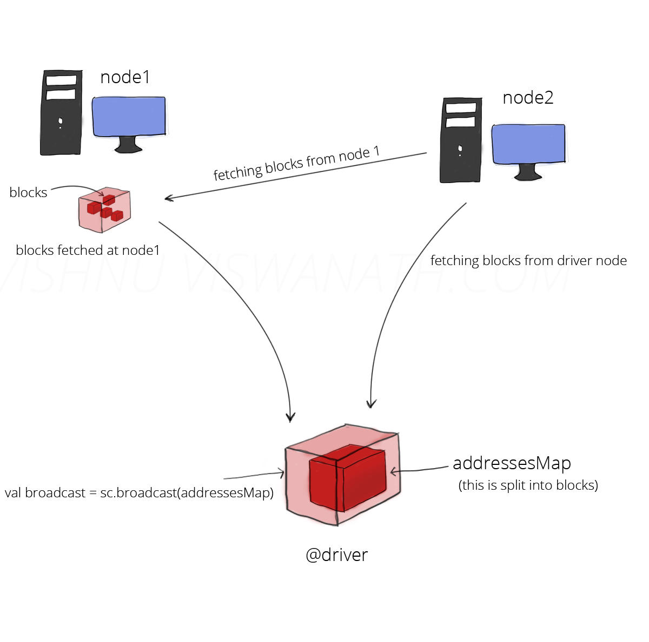
Broadcast & Accumulators
http://datalakes.com/rdds-simplified2/
Notes:
If there is time

Slide 24
Execution workflow
DAG
TaskSet
Task
Driver Program
RDDs
DAGScheduler
Cluster
Manager
Executor
RDD₁
RDD₂
_{P}
_{P}
_{P}
_{P}
_{val conf = new SparkConf()}
val sc = new SparkContext(conf)
…
_{rdd1.join(rdd2)}
_{.filter(...)}
_{Threads}
_{P}
_{P}
_{P}
_{Block Manager}
_{P}
_{P}
_{P}
Build the operators DAG
Notes:
The partitions diagram be rotated 90 degrees

Slide 25
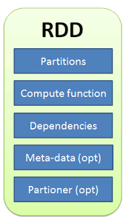
Resilient Distributed Dataset (RDD)
RDD Properties
Distributed
Immutable
Fault-tolerant
Lazily evaluated
Serializable
Cacheable
Type safe

Slide 26
RDD - Resilient Distributed Dataset
What is it?
RDD data is just a collection of partitions distributed in the cluster nodes
Can be created
From storage (distributed file system, dataset, plain file)
From another RDD
Stores information about parent RDDs
For execution optimization and operation pipelining
To re-compute the data in case of failure
Overall objective
Support a wide array of operations and compositions (more than map and reduce)
Computations on RDDs
Are represented by lazily evaluated lineage DAGs composed by chain RDDs

Slide 27
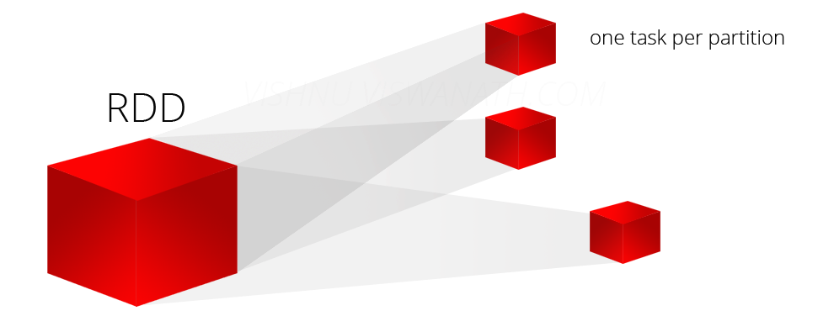
Partitions
RDDs are automatically distributed across the network by means of partitions
A partition is a logical division of data
Partitions are basic units of parallelism
Spark automatically decides the number of partitions when creating an RDD
Partitions from HDFS are distributed by default
Partitions are also location aware (data locality)
Computed data can be distributed in memory also using caching
All partitions are immutable (fault-tolerance)
A task is launched per partition

Slide 28
Execution workflow
DAG
TaskSet
Task
Driver Program
RDDs
DAGScheduler
Cluster
Manager
Executor
RDD₁
RDD₂
_{P}
_{P}
_{P}
_{P}
_{val conf = new SparkConf()}
val sc = new SparkContext(conf)
…
_{rdd1.join(rdd2)}
_{.filter(...)}
_{Threads}
_{P}
_{P}
_{P}
_{Block Manager}
_{P}
_{P}
_{P}
split graph into stages of tasks
submit each stage as ready
Notes:
The partitions diagram be rotated 90 degrees

Slide 29
DAG Scheduler
The DAGScheduler is the scheduling layer of Apache Spark that implements stage-oriented scheduling
It keeps track of which RDDs and stage outputs are materialized and finds a minimal schedule to run jobs
DAGScheduler does the following:
Computes an execution DAG, i.e. DAG of stages for a job
Determines the preferred locations to run each task on (based on the current cache status)
Handles failures due to shuffle output files being lost
Tries to minimize shuffling based on partitioning algorithms
Submit tasks to the cluster manager scheduler (e.g.Mesos)

Slide 30
RDD Dependency Types
Narrow Dependencies (pipelined)
Each child partition depends on only one parent
In case of co-partitioned joins we can have more than one parents
Task can be executed locally and we don’t have to shuffle
e.g. transformations - map, flatMap, filter
Wide Dependencies (shuffle)
Multiple child partitions may depend on one partition of the parent RDD
This means we have to shuffle data
e.g. transformations sortByKey, reduceByKey, groupByKey, cogroupByKey, join, cartesian

Slide 31
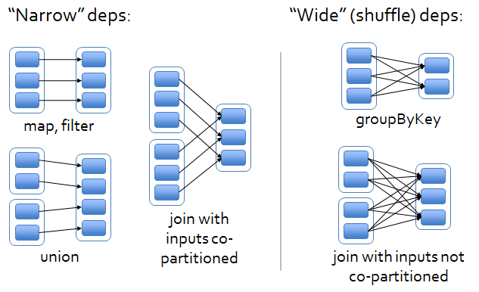
RDD Dependency Types

Slide 32
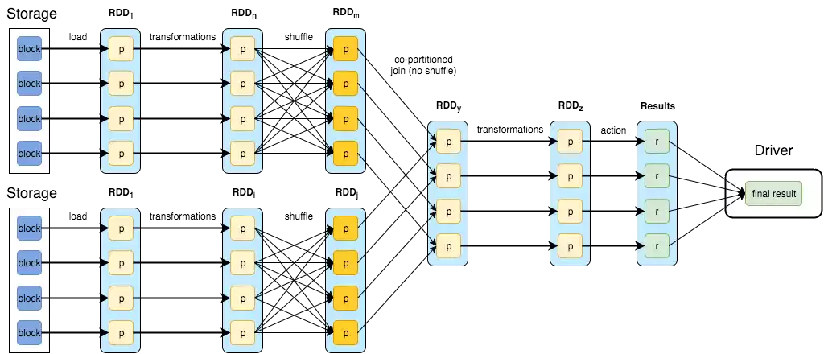
DAG Scheduler
http://datastrophic.io/core-concepts-architecture-and-internals-of-apache-spark/

Slide 33
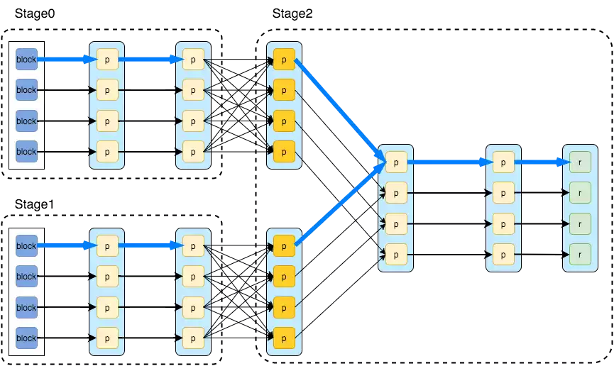
DAG Scheduler
http://datastrophic.io/core-concepts-architecture-and-internals-of-apache-spark/

Slide 34
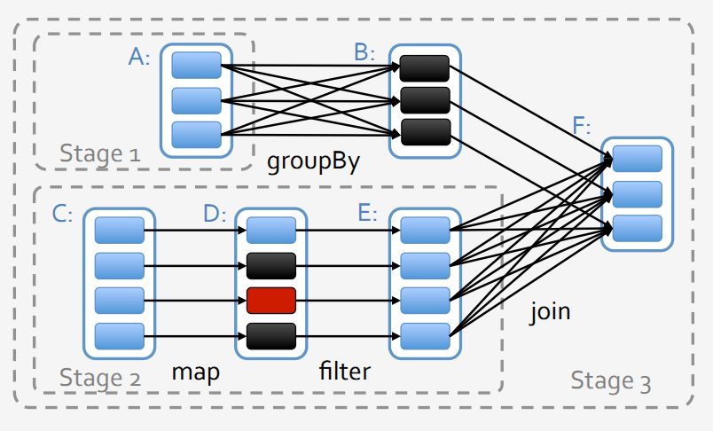
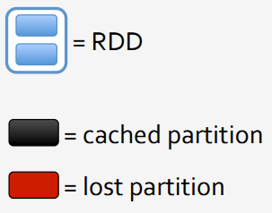
Fault-tolerance
Recovery after a node failure using the lineage
More efficient with a narrow dependency
re-compute only the lost parent partitions
re-compute in parallel across nodes
wide dependencies
a single failed node might cause the loss of some partition from all ancestors of an RDD
requiring a complete re-execution
https://stanford.edu/~rezab/classes/cme323/S15/slides/devops_slides.pdf

Slide 35
Task Scheduler
Task Scheduler
responsible for sending tasks to the cluster
executing them
retrying if there are failures and mitigating strugglers
reports to the DAG Scheduler

Slide 36
Execution workflow
DAG
TaskSet
Task
Driver Program
RDDs
DAGScheduler
Cluster
Manager
Executor
RDD₁
RDD₂
_{P}
_{P}
_{P}
_{P}
_{val conf = new SparkConf()}
val sc = new SparkContext(conf)
…
_{rdd1.join(rdd2)}
_{.filter(...)}
_{Threads}
_{P}
_{P}
_{P}
_{Block Manager}
_{P}
_{P}
_{P}
launches tasks via cluster manager
retries failed or struggling tasks
Notes:
The partitions diagram be rotated 90 degrees

Slide 37
Cluster Manager
Cluster Manager
spark is agnostic of the cluster manager
allows plugging in different cluster resource management implementations
resource allocation (static by default – dynamic allocation is also provided)
Standalone - a simple cluster manager included with spark
Apache Mesos – a general cluster manager that can also run Hadoop MapReduce
Hadoop Yarn – the resource manager in Hadoop 2

Slide 38
Execution workflow
DAG
TaskSet
Task
Driver Program
RDDs
DAGScheduler
Cluster
Manager
Executor
RDD₁
RDD₂
_{P}
_{P}
_{P}
_{P}
_{val conf = new SparkConf()}
val sc = new SparkContext(conf)
…
_{rdd1.join(rdd2)}
_{.filter(...)}
_{Threads}
_{P}
_{P}
_{P}
_{Block Manager}
_{P}
_{P}
_{P}
executes tasks
stores and serves blocks
Notes:
The partitions diagram be rotated 90 degrees

Slide 39

Executor
The computation workforce
Each worker can have more than one executors
Each executor has its own JVM
Each task uses a single thread
The block manager provides the interfaces for retrieving and putting blocks both locally and remotely into various stores
memory, disk, off-heap
Notes:
Convert with separate slides (one for each) and a diagram that shows the association between them

Slide 40
Sum up so far
Spark is a cluster computing framework
Driver is responsible for describing and driving the computation
RDDs are the basic computing abstraction in Spark
distributed, immutable, lazy, fault-tolerant
holds the partitions, the computation and some other metadata
DAG Scheduler
responsible for organizing tasks in stages
based on partition dependencies
Spark is cluster manager agnostic
Executors are the workhorses
Notes:
Convert with separate slides (one for each) and a diagram that shows the association between them

Slide 41
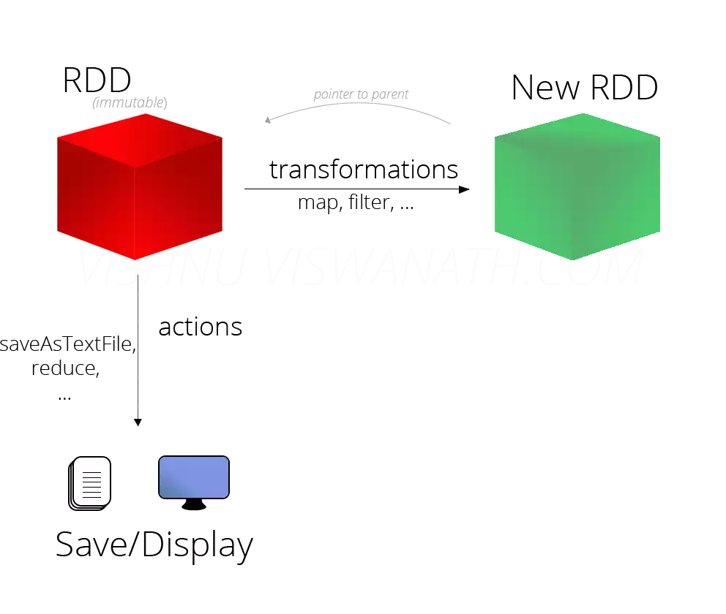
RDD: Operations
http://datalakes.com/spark-rdds-simplified-part-2/

Slide 42
RDD - Transformations
Set of operations on RDD that define how they should be transformed
Introduce dependencies between RDDs to form DAG
Either Apply user function to every element in a partition or to the whole partition
Or Apply aggregation function to the whole dataset (groupBy, sortBy)
Provide functionality for repartitioning (repartition, partitionBy)

Slide 43
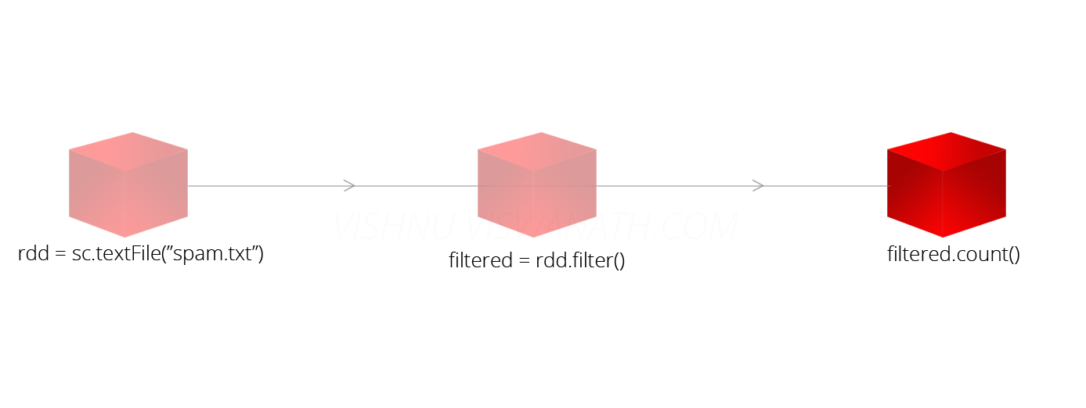
RDD - Transformations
Every application of a transformation to an RDD yields a new RDD (immutability)
Transformations are lazily evaluated which allow for optimizations to take place before execution
The lineage keeps track of all transformations that have to be applied when an action happens
http://datalakes.com/rdds-simplified/

Slide 44
RDD Transformations
map() | groupByKey()
flatMap() | reduceByKey()
filter() | sortByKey()
mapPartitions() | join()
mapPartitionsWithIndex() | cogroup()
sample() | cartesian()
union() | pipe()
intersection() | coalesce()
distinct() | repartion()
cache() | partitionBy()
persist() | ...

Slide 45
RDD Common Transformations
Unary | RDD | Result
rdd. map(x => x * x) | {1, 2, 3, 3} | {1, 4, 9, 9}
rdd.flatMap(line => line.split(" ")) | {"hello world", "hi"} | {"hello”, world", "hi"}
rdd.filter(x => x != 1) | {1, 2, 3, 3} | {2, 3, 3}
rdd.distinct () | {1, 2, 3, 3} | {1, 2, 3}
Binary | RDD | Other | Result
rdd.union (other) | {1, 2, 3} | {3,4,5} | {1,2,3,3,4,5}
rdd.intersection(other) | {1, 2, 3} | {3,4,5} | {3}
rdd.subtract(other) | {1, 2, 3} | {3,4,5} | {1, 2}
rdd.cartesian(other) | {1, 2, 3} | {3,4,5} | {(1,3),(1,4), … (3,5)}

Slide 46
Unary Transformations on Pairs
reduceByKey(func): Combine values with the same key.
groupByKey(): Group values with the same key.
mapValues(func): Apply a function to each value of a pair RDD without changing the key.
Example Scala | RDD | Result
rdd.reduceByKey ((x, y) => x + y) | {(1,2),(3,4),(3,6)} | {(1,2),(3,10)}
rdd.groupByKey() | {(1,2),(3,4),(3,6)} | {(1,[2]),(3,[4,6])}
rdd.mapValues(x => x+1) | {(1,2),(3,4),(3,6)} | {(1,3),(3,5),(3,7)}

Slide 47
Unary Transformations on Pairs
keys(): Return an RDD of just the keys.
values(): Return an RDD of just the values.
sortByKey(): Return an RDD sorted by the key.
Example Scala | RDD | Result
rdd.keys() | {(1,2),(3,4),(3,6)} | {1,3,3}
rdd.values() | {(1,2),(3,4),(3,6)} | {2,4,6}
rdd.sortByKey() | {(1,2),(3,4),(3,6)} | {(1,2),(3,4),(3,6)}

Slide 48
Binary Transformations on Pairs
subtractByKey: Remove elements with a key present in the other RDD.
join: Perform an inner join between two RDDs.
leftOuterJoin: Perform a join between two RDDs where the resulting pair RDD has entries for each key in the first RDD.
Example Scala | RDD | Other | Result
rdd.subtractByKey(other) | {(1,2),(3,4),(3,6)} | {(3,9)} | {(1,2)}
rdd.join(other) | {(1,2),(3,4),(3,6)} | {(3,9)} | {(3,(4,9)),(3,(6,9))}
rdd.leftOuterJoin(other) | {(1,2),(3,4),(3,6)} | {(3,9)} | {(1,(2,None)), (3,(4,Some(9))), (3,(6,Some(9)))}

Slide 49
Binary Transformations on Pairs
rightOuterJoin: Perform a join between two RDDs where resulting pair RDD has entries for each key in the other RDD.
cogroup: Group data from both RDDs sharing the same key.
Example Scala | RDD | Other | Result
rdd.rightOuterJoin(other) | {(1,2),(3,4),(3,6)} | {(3,9)} | {(3,(Some(4),9)), (3,(Some(6),9))}
rdd.cogroup(other) | {(1,2),(3,4),(3,6)} | {(3,9)} | {(1,([2],[])), (3,([4,6],[9]))}

Slide 50
RDD operations - Actions
Apply transformation chains on RDDs, eventually performing some additional operations (e.g. counting)
i.e. trigger job execution
Used to materialize computation results
Results are returned to the driver
Some actions only store data from the RDD upon which the action is applied and convey it to the driver (e.g. print, collect, etc)

Slide 51
RDD Actions
reduce() | takeOrdered()
collect() | saveAsTextFile()
count() | saveAsSequenceFile()
first() | saveAsObjectFile()
take() | countByKey()
takeSample() | forEach()
saveToCassandra() | ...

Slide 52
RDD Actions
reduce(): Takes a function that operates on two elements of the type in your RDD and returns a new element of the same type. The function is applied on all elements.
fold(): also takes a function with the same signature as needed for reduce(), but in addition takes a “zero value” to be used for the initial call on each partition.
 | RDD | Result
rdd.reduce((x, y) => x + y) | {1,2,3} | 6
val rdd = sc.makeRDD(List(100, 800, 2200)) val min= 0 val max = rdd.fold(min)((a,b) => {if(a < b) b else a}) println("max number is " + max) Output: max number is 2200
Notes:
Run it to check validiy

Slide 53
RDD Actions
collect(): returns the entire RDD’s contents (commonly used in unit tests where the entire contents of the RDD are expected to fit in memory). The restriction here is that all of your data must fit on a single machine, as it all needs to be copied to the driver.
take(): returns n elements from the RDD and tries to minimize the number of partitions it accesses. No expected order
count(): returns the number of elements
Example | RDD | Result
rdd.collect() | {1,2,3} | {1,2,3}
rdd.take(2) | {1,2,3,4} | {1,3}
rdd.count() | {1,2,3,3} | 4

Slide 54
RDD Actions
foreach(func): Apply the provided function to each element of the RDD.
Example | RDD | Result
val rdd1 = sc.parallelize(List(1, 2, 3, 3)) rdd.foreach(a=>print (a)) | {1,2,3,3} | {1,3,2,3}

Slide 55
Actions on Pairs
countByKey(): Count the number of elements for each key. Returns a hashmap of (K, Int) pairs with the count of each key.
lookup(key): Return all values associated with the provided key.
Example Scala | RDD | Result
rdd.countByKey() | {(1,2),(3,4),(3,6)} | {(1,1),(3,2)}
rdd.lookup(3) | {(1,2),(3,4),(3,6)} | [4, 6]

Slide 56
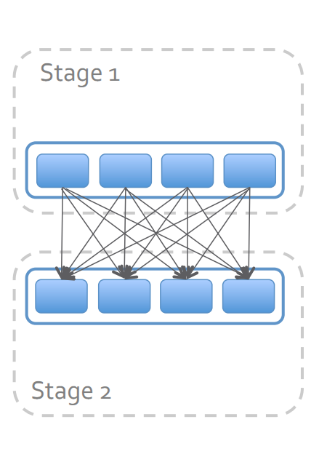
Shuffle
Redistributes data among partitions
Sort-Based Partitioning by default
Optimizations:
Avoided when possible, if data is already properly partitioned
Partial aggregation reduces data movement
Operations that trigger shuffle event:
repartition, reduceByKey, combineByKey, groupBy, cogroup, join
Notes:
Sort-Based, Hash-based

Slide 57
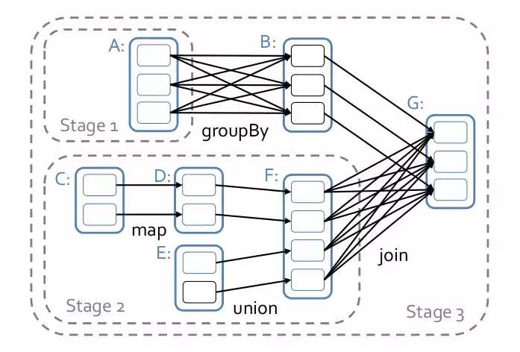
Shuffle
Diagram from Spark Shuffle Introduction

Slide 58
Why Shuffle is expensive
During shuffle data no longer stays in memory
Shuffling involves
Data partition which might involve very expensive data sorting works
Serialization/Deserialization to transfer data through the network or across processes
Data compression to reduce IO
increases CPU usage though
Disk IO multiple times on one single data block

Slide 59
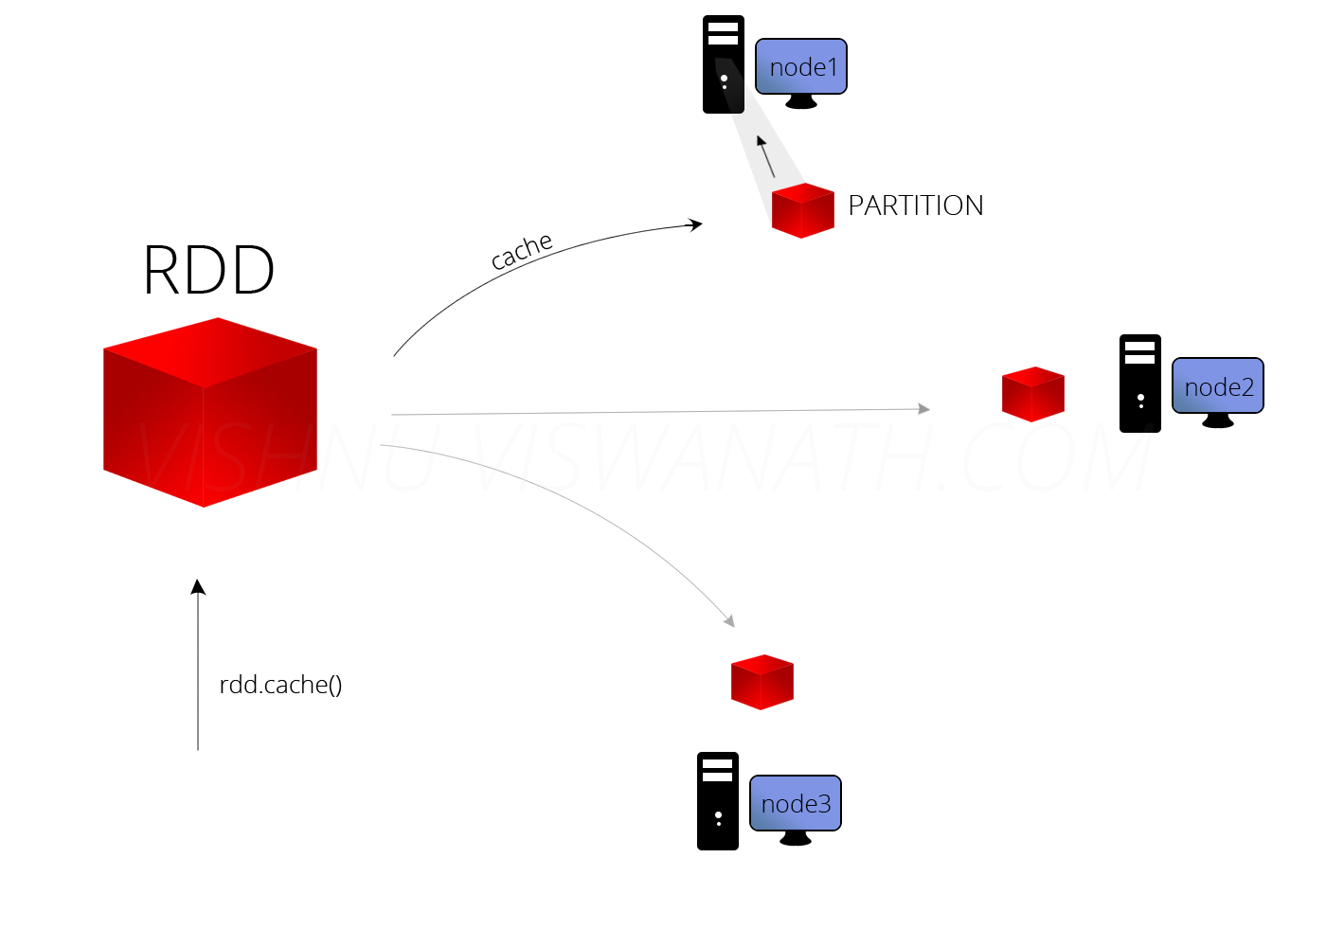
Persistence - rdd.cache()
If we need the results of an RDD many times, it is best to cache it
RDD partitions are loaded into the memory of the nodes that hold it
avoids re-computation of the entire lineage
in case of node failure compute the lineage again
http://datalakes.com/rdds-simplified/

Slide 60
Persistence - levels
Level | Space Used | CPU Time | In Memory | On Disk
MEMORY_ONLY* | High | Low | Yes | No
MEMORY_ONLY_SER | Low | High | Yes | No
MEMORY_AND_DISK** | High | Medium | Some | Some
MEMORY_AND_DISK_SER*** | Low | High | Some | Some
DISK_ONLY | Low | High | No | Yes
* If the RDD does not fit in memory, some partitions will not be cached and will be recomputed on the fly each time they're needed. This is the default level.
** Spills to disk if there is too much data to fit in memory.
*** Spills to disk if there is too much data to fit in memory. Stores serialized representation in memory.
Notes:
MEMORY_ONLY: Store RDD as deserialized Java objects in the JVM. If the RDD does not fit in memory, some partitions will not be cached and will be recomputed on the fly each time they're needed. This is the default level.
MEMORY_ONLY_SER: Store RDD as serialized Java objects (one byte array per partition). This is generally more space-efficient than deserialized objects, but more CPU-intensive to read.
MEMORY_AND_DISK: Store RDD as deserialized Java objects in the JVM. If the RDD does not fit in memory, store the partitions that don't fit on disk, and read them from there when they're needed.
MEMORY_AND_DISK_SER: Similar to MEMORY_ONLY_SER, but spill partitions that don't fit in memory to disk instead of recomputing them on the fly each time they're needed.
DISK_ONLY: Store the RDD partitions only on disk.
Generally, don’t spill to disk unless the functions that computed your datasets are expensive, or they filter a large amount of the data. Otherwise, recomputing a partition may be as fast as reading it from disk.

Slide 61
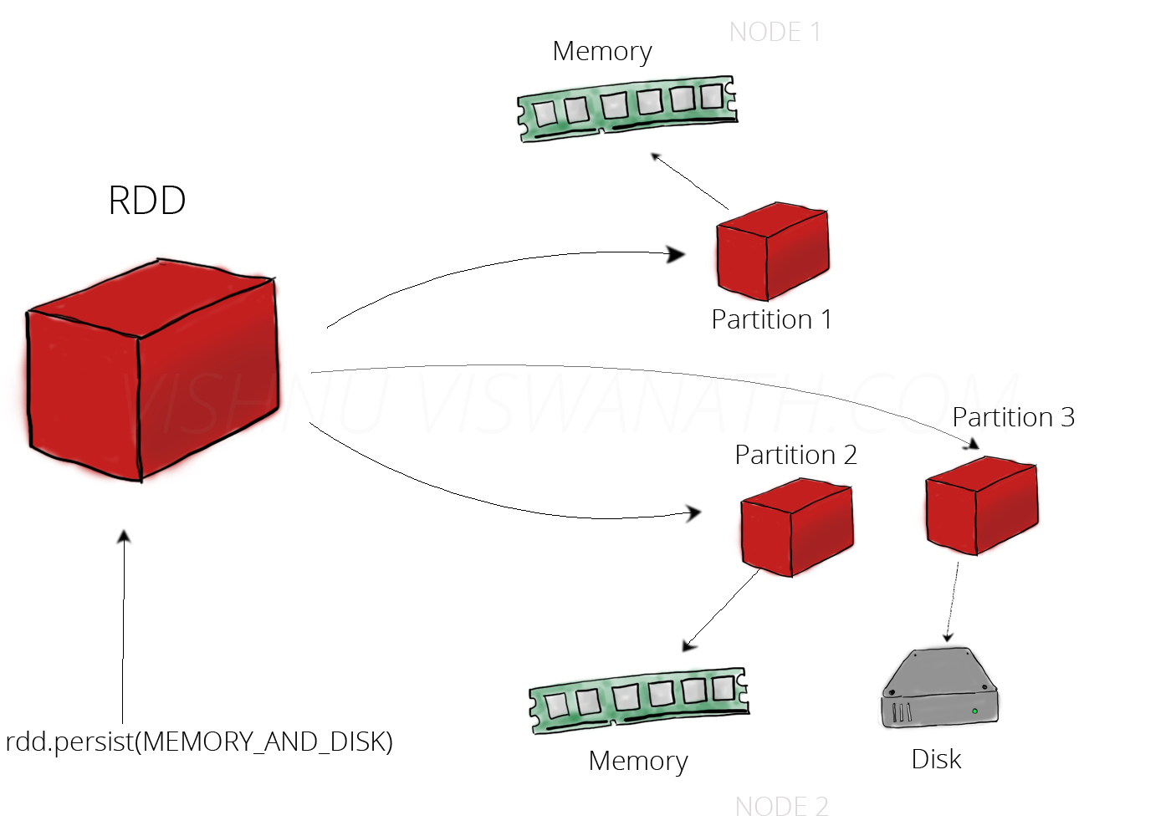
Persistence – rdd.persist()
http://datalakes.com/rdds-simplified2/

Slide 62
Determinants of Performance in Spark
Quantity of data shuffled
In general avoiding shuffle will make your program run faster
Filter input earlier in the program rather than later
Switching to LZF compression can improve shuffle performance
Degree of Parallelism
If you have a huge number of tasks operating in small partitions (e.g. 10’s of thousands), then it is often good to coalesce
If you are not using all slots in your cluster, repartition can increase parallelism
Notes:
LZF is a very fast compression algorithm

Slide 63
Determinants of Performance in Spark
Serialization
Serialization is sometimes the bottleneck when suffling and caching data
Using the kryo serializer is often faster
Almost 10x faster than default Java
Cache format
By default Spark will cache data using MEMORY_ONLY level de-serialized JVM objects
MEMORY_AND_DISK can avoid expensive re-computations

Slide 64
Things to remember!
RDDs are expensive when
Serialize / De-serialize
Write to disk
Network transfer
RDDs are cheap when
No serialization
No Disk IO
Pipelined
Be careful!
It is easy to build an inefficient RDD lineage
rdd.groupBy().filter() more expensive rdd.filter().groupBy()

Slide 65
Wrapping up
val conf = new SparkConf()
.setAppName("WordCount").setMaster("spark://139.91.183.88:7077")
val sc = new SparkContext(conf)
sc.textFile("hdfs://139.91.183.88:9000/data/food.txt") RDD[String]
textFile
Notes:
Lets quickly view a spark application with respect to how this is translated in spark

Slide 66
Wrapping up
val conf = new SparkConf()
.setAppName("WordCount").setMaster("spark://139.91.183.88:7077")
val sc = new SparkContext(conf)
sc.textFile("hdfs://139.91.183.88:9000/data/food.txt") RDD[String] .flatMap(line=>line.split(" ")) RDD[List[String]]
textFile
flatMap

Slide 67
Wrapping up
val conf = new SparkConf()
.setAppName("WordCount").setMaster("spark://139.91.183.88:7077")
val sc = new SparkContext(conf)
sc.textFile("hdfs://139.91.183.88:9000/data/food.txt") RDD[String] .flatMap(line=>line.split(" ")) RDD[List[String]]
.map(word=>(word, 1))) RDD[(String, Int)]
textFile
flatMap
map

Slide 68
Wrapping up
val conf = new SparkConf()
.setAppName("WordCount").setMaster("spark://139.91.183.88:7077")
val sc = new SparkContext(conf)
sc.textFile("hdfs://139.91.183.88:9000/data/food.txt") RDD[String] .flatMap(line=>line.split(" ")) RDD[List[String]]
.map(word=>(word, 1))) RDD[(String, Int)]
.reduceByKey(_ + _) RDD[(String, Int)]
textFile
flatMap
map
reduceByKey

Slide 69
Wrapping up
val conf = new SparkConf()
.setAppName("WordCount").setMaster("spark://139.91.183.88:7077")
val sc = new SparkContext(conf)
sc.textFile("hdfs://139.91.183.88:9000/data/food.txt") RDD[String] .flatMap(line=>line.split(" ")) RDD[List[String]]
.map(word=>(word, 1)) RDD[(String, Int)]
.reduceByKey(_ + _) RDD[(String, Int)]
.collect() Array[(String, Int)]
textFile
flatMap
map
reduceByKey
collect

Slide 70
Wrapping up
Stages are sequence of RDDs
that don’t have a shuffle in between
Stage 1
Stage 2
textFile
flatMap
map
reduceByKey
collect
Notes:
Αλληλουχία

Slide 71
Wrapping up
One stage can be thought of as the set of computations that can each be computed on one executor without communication with other executors or with the driver.
Stage 1
Stage 2
Read HDFS split
Apply flatMap & map
Start Partial reduce
Write shuffle data
Read shuffle data
Final reduce
Send result to driver program

Slide 72
Wrapping up
Stages consists of multiple tasks (the smallest units of work in Spark)
A task is created for each Partition in the RDD
Tasks are Scheduled and shipped to Workers.
On workers, the executors will run the individual tasks in parallel and will save the results.
Task 1
Task 2
Task 3
Task 4

Slide 73


Slide 74
Code Examples
Core Basic

Slide 75
Problem
Considering the following csv file,
where data is organized as
Country | Zone | Temperature,
find the average temperature per
country zones
countryZoneTemp.csv
India,Z1,22 Australia,Z1,24 India,Z2,24 Australia,Z1,29 India,Z2,28

Slide 76
How to solve it
Steps:
1. Load data line by line
2. Split each line to get each value separately
3. Create records holding the different temperatures per country-zone
4. Aggregate and Compute the average
countryZoneTemp.txt
India,Z1,22 Australia,Z1,24 India,Z2,24 Australia,Z1,29 India,Z2,28

Slide 77
Setup Spark Driver
Create SparkConf and SparkContext
import org.apache.spark.SparkConf
import org.apache.spark.SparkContext
object AverageZoneTemperature {
def main(args: Array[String]) = {
val conf = new SparkConf()
.setAppName("SparkWordCountJoinExample")
.setMaster("spark://<master-ip>:7077")
val sc = new SparkContext(conf)
Notes:
SparkContext: It is an object that represents a connection to the computing cluster.
The set of jobs in the spark application are defined by one SparkContext.
A Spark application begins when a SparkContext is started.
When the Spark Context is started, each worker node starts one or more executors (its own Java Virtual Machine, JVM) that will execute the work in parallel for each partition.

Slide 78
1. Loading data
Create an RDD to load the lines of the file
val baseRDD = sc.textFile("<file_Path>/countryZoneTemp.txt")
At computation time, each line of the file will form each element of the RDD:
countryZoneTemp.txt
India,Z1,22 Australia,Z1,24 India,Z2,24 Australia,Z1,29 India,Z2,28
Blocks
…
RDD 1
01101010001001
00111010011011
India,Z1,22
Australia,Z1,24
Transform
India,Z2,24
Australia,Z1,29
India,Z2,28
11100011000100
00011001101111

Slide 79
2. Split each line
Use map to split into words
.map(x => x.split(","))
At computation time the new RDD will be formed as Array[Array[String]]:
RDD 1
RDD 2
India,Z1,22
Australia,Z1,24
Transform with map
to Split into words
(India, Z1, 22)
(Australia, Z1, 24)
India,Z2,24
Australia,Z1,29
India,Z2,28
(India, Z2, 24)
(Australia, Z1, 29)
(India, Z2, 28)

Slide 80
3. Create records
Form Pairs <Key, Value> Use map again to transform the RDD into <Key, Value> pair
.map(x => ((x(0), x(1)), x(2).toInt))
At computation time the new RDD will be formed as Array[((String, String), Int)]:
RDD 2
RDD 3
(India, Z1, 22)
(Australia, Z1, 24)
Transform with map
to form
<Key, Value> pair
((India,Z1),22)
((Australia,Z1),24)
(India, Z2, 24)
(Australia, Z1, 29)
(India, Z2, 28)
((India,Z2),24)
((Australia,Z1),29)
((India,Z2),28)

Slide 81
3. Create records
Use aces to count the duplicated keys Use mapValues to count each value in pair
.mapValues((_, 1))
At computation time the new RDD will be formed as Array[((String, String), (Int, Int))]:
RDD 3
RDD 4
((India,Z1),22)
((Australia,Z1),24)
Transform values
to form <temperature, 1> pair
((India,Z1),(22,1)) ((Australia,Z1),(24,1))
((India,Z2),24)
((Australia,Z1),29)
((India,Z2),28)
((India,Z2),(24,1)) ((Australia,Z1),(29,1)) ((India,Z2),(28,1))

Slide 82
4. Aggregate
Use reduceByKey to aggregate and sum up values
.reduceByKey((x, y) => (x._1 + y._1, x._2 + y._2))
At computation time the new RDD will be still formed as before, but also reduced such that the same country-zone keys are aggregated and counted by summing up the aces.
RDD 4
RDD 5
((India,Z1),(22,1)) ((Australia,Z1),(24,1))
Transform to
Reduce keys
And sum up aces
((India,Z1),(22,1)) ((India,Z2),(52,2))
((India,Z2),(24,1)) ((Australia,Z1),(29,1)) ((India,Z2),(28,1))
((Australia,Z1),(53,2))

Slide 83
4. And Compute the average
Use mapValues(x => f(x)) again to compute the average
.mapValues((x) => x._1.toDouble / x._2)
At computation time the new RDD will be formed as: Array[((String, String), Double)]
RDD 5
RDD 6
((India,Z1),(22,1)) ((India,Z2),(52,2))
Transform to
Reduce keys
And sum up aces
((India,Z1),22.0)
((India,Z2),26.0)
((Australia,Z1),(53,2))
((Australia,Z1),26.5)

Slide 84
Execute the computation
Recall that up to now nothing has actually been computed
… we have only expressed the desired computations
due to lazy evaluation of the transformations
So, we need an action that will trigger the work
For example we can collect all the elements of the RDD and print them out
.collect()
.foreach(println)
}
}

Slide 85
Call action
Collect all the elements of the RDD and print them out
.collect()
.foreach(println)
}
}

Slide 86
The Whole App
import org.apache.spark.{SparkConf, SparkContext}
object AverageZoneTemperature {
def main(args: Array[String]) = {
val conf = new SparkConf()
.setAppName("SparkWordCountJoinExample")
.setMaster("spark://<master-ip>:7077")
val sc = new SparkContext(conf)
println("Average by country and zone")
val baseRDD = sc.textFile("<path to file>/countryZoneTemp.txt")
.map(x => x.split(","))
.map(x => ((x(0), x(1)), x(2).toInt))
.mapValues((_, 1))
.reduceByKey((x, y) => (x._1 + y._1, x._2 + y._2))
.mapValues { case (sum, count) => sum.toDouble / count } .collectAsMap()
.foreach(println)
}
}

Slide 87
Spark MLlib
Machine Learning

Slide 88
Spark MLlib
Spark supports a number of machine learning algorithms (iterative)
Classification - Linear Support Vector Machine, Naïve Bayes
Regression - Linear, Logistic
Collaborative Filtering – Alternating Least Squares (ALS)
Clustering - K-means, Gaussian Mixtures
Topic Modeling – LDA
Decision Trees
Dimensionality Reduction – Singular Value Decomposition (SVD), Principal Component Analysis (PCA)

Slide 89
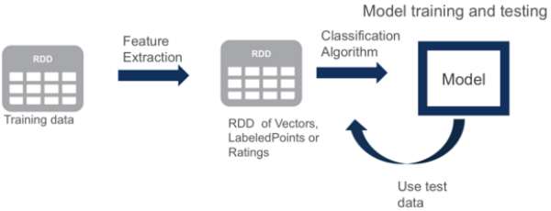
Spark MLlib

Slide 90
K-means
// import whatever we need
// load and parse the data
val data = sc.textFile("kmeans_data.txt")
val parsedData = data.map(x => x.split(" "))
.map(x => x.toDouble).cache()
// Cluster the data into 2 clusters using kmeans
val clusters = KMeans.train(parsedData, 2,
numIterations = 20)
// Compute the sum of squared errors
val cost = clusters.computeCost(parsedData)
println("Sum of squared errors = " + cost)
// save and load the model
clusters.save(sc, "target/org/apache/spark/KMeansExample/KMeansModel")
val sameModel = KMeansModel.load(sc, "target/org/apache/spark/KMeansExample/KMeansModel")
kmeans_data.txt
0.0 0.0 0.0
0.1 0.1 0.1
0.2 0.2 0.2
9.0 9.0 9.0
9.1 9.1 9.1
9.2 9.2 9.2

Slide 91
Collaborative Filtering
test_data.txt
1,1,5.0
1,2,1.0
1,3,5.0
2,1,5.0
2,2,5.0
2,4,1.0
// import whatever we need
// load and parse the data
val data = sc.textFile("data/mllib/als/test.data")
val ratings = data.map(_.split(',') match {
case Array(user, item, rate) =>
Rating(user.toInt, item.toInt, rate.toDouble)
// Rating class provided by MLlib
}).cache()
// build the recommendation model using ALS
val rank = 10
val numIterations = 10
val model = ALS.train(ratings, rank, numIterations, 0.01)

Slide 92
Collaborative Filtering
// Evaluate the model on rating data
val usersProducts = ratings.map {
case Rating(user,product,rate) => (user,product)
}
val predictions= model.predict(userProducts).map{
case Rating(user,product,rate) => ((user,product), rate)
}
val ratesAndPreds= ratings.map{
case Rating(user,product,rate)=>((user,product), rate)
}.join(predictions)
val MSE = ratesAndPreds.map{
case((user,product),(r1,r2)) => val err = (r1-r2)
err * err
}.mean()
println(“Mean Squared Error = " + MSE)
// Save and load the model
model.save(sc, "target/tmp/myModel")
val sameModel = MatrixFactorizationModel.load(sc, "target/tmp/myModel")

Slide 93
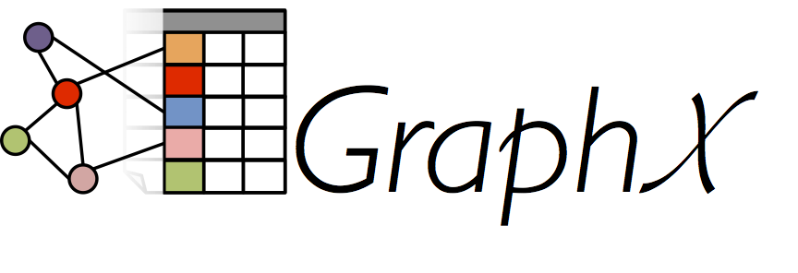
Graph Analytics

Slide 94
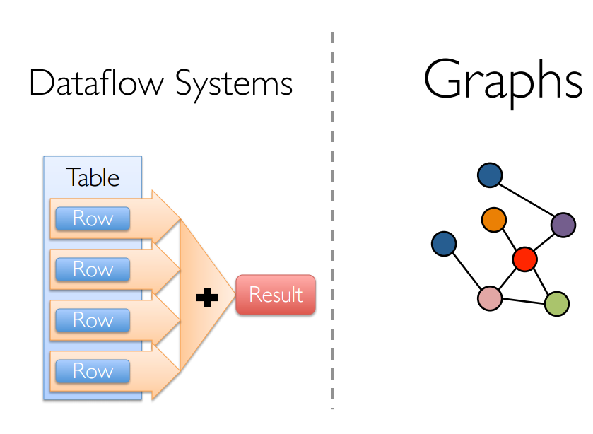
Spark GraphX
Data parallel operations – apply the same computation to different data
Graph parallel operations – iterative vertex centric algorithms

Slide 95
Spark GraphX
A young component in Spark for graph-parallel computation
Used for graph-analytics tasks
Graph analytics is a part of a larger processing pipeline
Coarse grained
Spark makes it easy to compose complex pipelines using both data-parallel and graph-parallel processing
GraphX is not a graph database
Graph databases provide transactions
Incremental updates

Slide 96
Spark GraphX
Many graph-parallel algorithms
Collaborative Filtering – SVD++
Community Detection – Triangle Counting
Connected Components
Label propagation
Graph Analytics – PageRank, Personalized PageRank

Slide 97
Spark GraphX
Extends RDDs by introducing a new Graph Abstraction
A directed multigraph with properties attached to each vertex and edge
Exposes a set of fundamental operators
Graph-based (inDegrees, outDegrees, degrees, vertices, edges, triplets)
Property-based operators (e.g. mapVertices, mapEdges, mapTriplets)
Structural based operators (e.g. subgraph, reverse)
Aggregation (e.g. collectNeighbors)
Immutable, distributed, and fault-tolerant

Slide 98
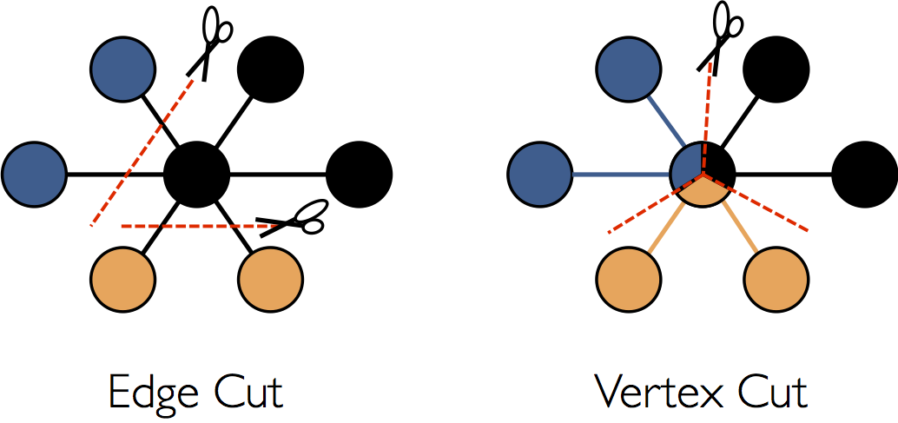
Spark GraphX
GraphX adopts a vertex-cut approach to distributed graph partitioning
Assign edges to machines and allowing vertices to span multiple machines
Vertex degrees of real world graphs tend to follow the Power Law
Reduces communication

Slide 99
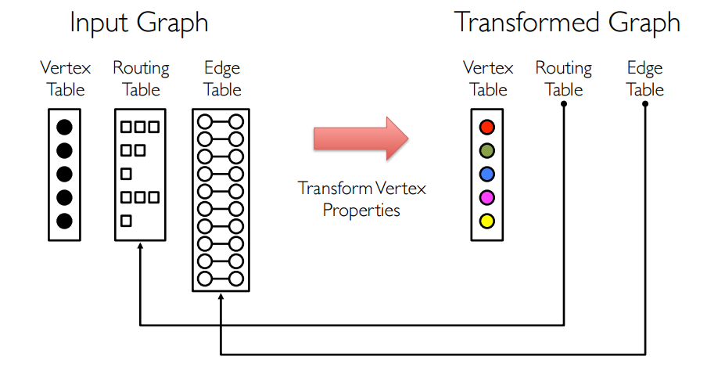
Spark GraphX
A graph is composed of three RDDs, one for vertices, one for edges and one for routing
Separate properties and structure to reuse structural information across multiple graphs

Slide 100
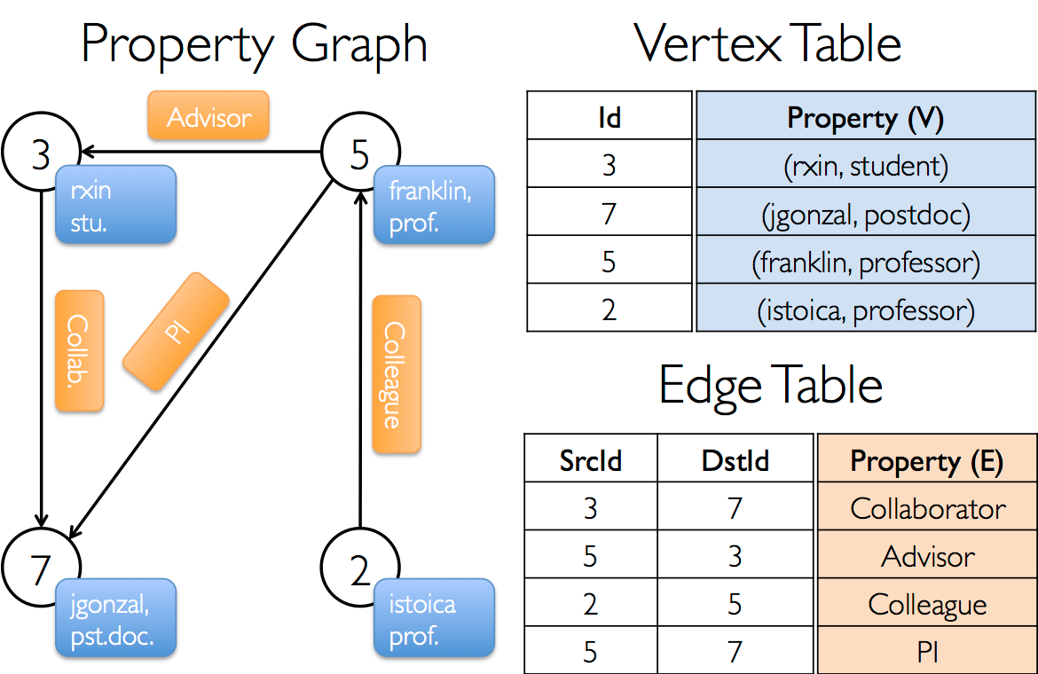
Spark GraphX

Slide 101
Create a graph
// import whatever we need
// Create an RDD for the vertices
val users:RDD[(VertexId, (String, String))] = sc.parallelize(
Array((3L, ("rxin, student")), (7L, ("jgonzal, postdoc")),
(5L, ("franklin, prof")), (2L, ("istoica, prof")))
// Create an RDD for the edges
val relationships:RDD[Edge[String]] = sc.parallelize(
Array(Edge(3L, 7L, "collab"), Edge(5L, 3L, "advisor"),
Edge(2L, 5L, "colleague"), Edge(5L, 7L, "PI"))
// Define a default user in case there are relationships with missing user
val defaultUser = ("John Doe", "Missing")
// Build the initial graph
val graph = Graph(users,relationships,defaultUser)

Slide 102
Run pagerank
// import whatever we need
// Load the edges of the graph
val graph = GraphLoader.edgeList(sc, "follower.txt")
// Run PageRank
val ranks = graph.pageRank(0.0001).vertices
// Join the ranks with the usernames
val users = sc.textFile("users.txt").map{ line =>
val fields = line.split(",")
(fields(0).toLong, fields(1))
}
val rankByUserName = users.join(ranks).map {
case(id, (username, rank)) => (username, rank)
}
// Print the result
println(ranksByUsername.collect().mkString("\n")
follower.txt
1,2
1,3
5,3
6,10
5,4
3,2
2,1

Slide 103
RDF & SPARQL
graphX does not natively support RDF… but there are ways to load RDF data
take advantage of the cluster for isomorphism, merging, computation of clustering co-efficient
Some approaches for Sparql using spark
S2X (2015)
Defines a mapping from RDF to the property graph model of GraphX
S2RDF (VLDB 2016)
Introduces ExtVP – A novel relational vertical partitioning schema for RDF
Uses semi-joins based preprocessing to minimize query input size
Based on Spark SQL

Slide 104
Spark SQL
DataFrames & Datasets

Slide 105
Spark SQL
Spark’s interface for working with structured and semi structured data.
Can load data from a variety of structured sources (i.e., JSON, Hive, Parquet*, external databases or existing RDDs).
It lets you query the data using SQL,
It allows you to use standard database connectors (JDBC/ODBC).
* Parquet is a column-oriented storage format available to any project in the Hadoop ecosystem, that can store records with nested fields efficiently.

Slide 106
Datasets
Datasets represent distributed collections like RDDs
The difference lies in the serialization mechanism
Datasets use a specialized Encoder to serialize the objects for processing or transmitting over the network
instead of Java serialization or kryo
Encoders allow Spark to perform many operations like filtering and sorting without de-serializing the bytes back into an object

Slide 107
DataFrames
DataFrames are Datasets with additional schema information
They store data in a more efficient manner than RDDs, taking advantage of their schema
Provide the ability to run SQL queries
Can be created from:
external data sources
the results of queries
regular RDDs

Slide 108
SparkSession
The entry point for working with Spark SQL is SparkSession.
This is how SparkSession can be constructed:
val spark = SparkSession.builder()
.appName("Spark SQL Example")
.config("spark.some.config.option", "some-value")
.getOrCreate()

Slide 109
DataFrame Operations
Assume that we have constructed a DataFrame based on the file people.json
Note that this file holds a collection of JSON objects rather than a single json object or array
val df = spark.read.json("examples/people.json")
people.json {"name":"Michael"}
{"name":"Andy", "age":30}
{"name":"Justin", "age":19}

Slide 110
DataFrame Operations
// Show the content of the DataFrame
df.show()
+----+-------+
| age| name|
+----+-------+
|null|Michael|
| 30| Andy|
| 19| Justin|
+----+-------+
// Print the schema in a tree format
df.printSchema()
root
|-- age: long (nullable = true)
|-- name: string (nullable = true)
// Count people by age
df.groupBy("age").count().show()
+----+-----+
| age|count|
+----+-----+
|null| 1|
| 19| 1|
| 30| 1|
+----+-----+
// Select only the "name" column
df.select("name").show()
+-------+
| name|
+-------+
|Michael|
| Andy|
| Justin|
+-------+
// Select everybody, but increment age by 1
df.select(df("name"), df("age") + 1).show()
+-------+---------+
| name|(age + 1)|
+-------+---------+
|Michael| null|
| Andy| 31|
| Justin| 20|
+-------+---------+
// Select people older than 21
df.filter(df("age") > 21).show()
+---+----+
|age|name|
+---+----+
| 30|Andy|
+---+----+

Slide 111
Converting RDDs to DataFrames
Regular RDDs can be converted to DataFrames by assigning them a schema
An RDD that contains case classes in Scala can be converted into a DataFrame
These case class define the schema of the table
If we are working with Java, we can use serializable classes with public getters and setters (JavaBeans)
An RDD converted to a DataFrame can be queried using SQL

Slide 112
JDBC To Other Databases
Spark can load data from any relational database that supports Java Database Connectivity (JDBC)
(i.e. postgreSQL, mySQL, h2, etc)
val jdbcDF = spark.read.format("jdbc")
.option("url", "jdbc:mysql://localhost:3306/someSchema")
.option("driver", "com.mysql.jdbc.Driver")
.option("user", "tom")
.option("password", "tom@#$5C09")
.option("dbtable", "person")
.load()
jdbcDF.createOrReplaceTempView("personTable")
spark.sql("select * from personTable").collect.foreach(println)

Slide 113
Example - Spark SQL
personprofile.json
{"name":"Tom", "address":{"city":"Grenoble", "country":"France"}}
{"name":"Alice", "address":{"city":"Heraklion", "country":"Greece"}}
…
citypopulation.json
{"city":"Grenoble", "population":162780}
{"city":"Heraklion", "population":225574}
…
Create a DataFrame from personprofile.json holding only Greek people
Create a DataFrame for citypopulation.json holding only cities with population less than 300000
Join the two Dataframes and print out <name> lives in <city> city, with population <population>, located in <country>

Slide 114
Example Spark SQL
// Encoders for most common types are automatically provided by
// importing from SparkSession implicits
val people = spark.read.json("file:/C:/myData/ex2/personprofile.json")
people.createOrReplaceTempView("people")
val greekPeople = spark.sql("SELECT name, address.city, address.country FROM people WHERE address.country=\"Greece\"")
val cityPopulation = spark.read.json("file:/C:/myData/ex2/citypopulation.json")
cityPopulation.createOrReplaceTempView("cityPopulation")
val smallCities = spark.sql("SELECT city, population FROM cityPopulation WHERE population<300000")
val greeksInSmallCities = smallCities.join(greekPeople, "city").show

Slide 115
Example Spark SQL
Output:
+---------+----------+------+-------+
| city|population| name|country|
+---------+----------+------+-------+
|Heraklion| 225574|Themis| Greece|
|Heraklion| 225574| Alice| Greece|
| Lefkada| 22652| John| Greece|
+---------+----------+------+-------+

Slide 116
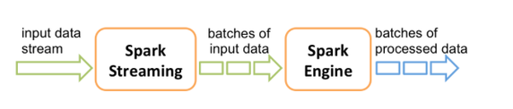
Spark Streaming

Slide 117
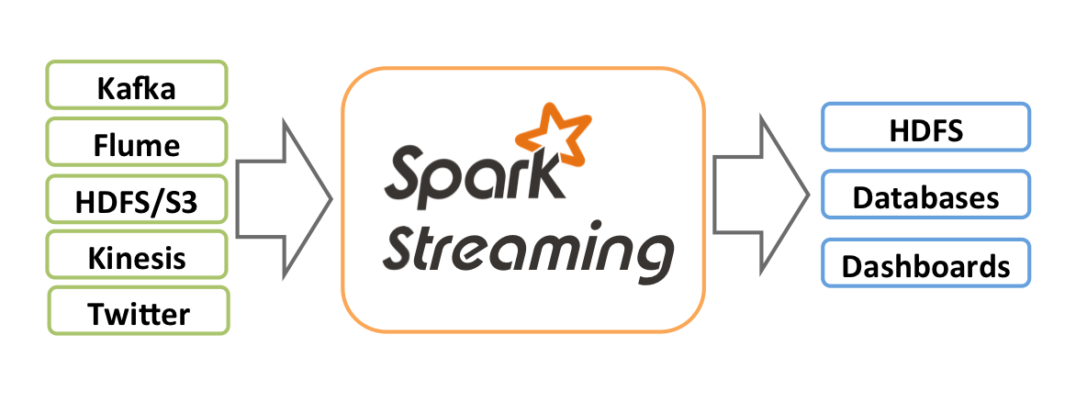
Spark Streaming
An extension of the Core Spark API
scalable,
high-throughput,
fault-tolerant
stream processing of live data streams.
Processed data can be pushed out to filesystems or databases
Notes:
Static vs continuously created data
Spark Streaming is a real-time processing tool that runs on top of the Spark engine.
Live data streams
Socket, intermediate tools
Store results
Apache Storm currently is the most popular tool for this job, which has higher industry adoption and better production stability compared to Spark Streaming. However Spark seems to provide a more expressive, higher level API than Storm, which might be more pleasant to use.
Apache Kafka can be used as a queue system for logs. The system that generated the logs e.g websever will send logs to Apache KAFKA. Then spark streaming library can be used to read from KAFKA topic and process logs at real time.

Slide 118
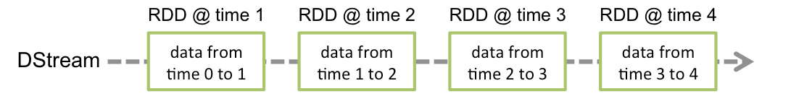
DStream
A high-level abstraction called discretized stream or DStream, which represents a continuous stream of data
DStreams can be created
from input data streams from sources such as Kafka, Flume, and Kinesis
by applying high-level operations on other DStreams
A DStream is represented as a sequence of RDDs
StreamingContext - the main entry point

Slide 119
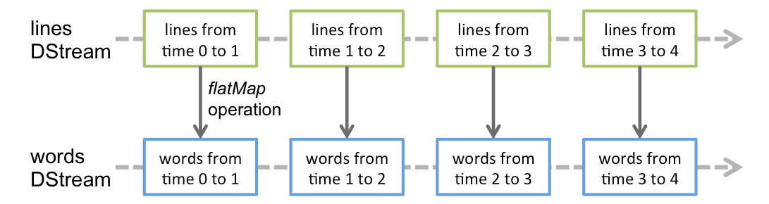
Operations applied on DStream
Operations applied on a DStream are translated to operations on the underlying RDDs
Use Case: Converting a stream of lines to words by applying the operation flatMap on each RDD in the “lines Dstream”.

Slide 120
DStream - Example
// Create a DStream that will connect to a server
// listening on a TCP socket, say <IP>:9990
val ssc = new StreamingContext(conf, Seconds(5))
val lines = ssc.socketTextStream("<Some_IP>", 9990)
// Word count again
val words = lines.flatMap(_.split(" "))
val pairs = words.map(word => (word.trim, 1))
val wordCounts = pairs.reduceByKey(_ + _)
wordCounts.print()
// Start the computation
ssc.start()
// Wait for the application to terminate
ssc.awaitTermination()
// ssc.stop() forces application to stop
Notes:
batch interval of 5 second.
Netcat: ένα TCP Socket που λαμβάνει text Data

Slide 121
File Streams
Besides sockets, the StreamingContext API provides methods for creating DStreams from files
Reading data from files on any file system compatible with the HDFS API (that is, HDFS, S3, NFS, etc.)
Spark Streaming will monitor a directory and process any files created in that directory

Slide 122
Check-points
A streaming application must be resilient to failures
Two types of check-points
Metadata check-pointing
Store information regarding the streaming computation to HDFS
Recovery from failures
Configuration, operations, incomplete batches
Data check-pointing
Store generated RDDs to HDFS
This is necessary in some stateful transformations

Slide 123
Transformations on DStreams
DStreams support most of the RDD transformations
Also introduces special transformations related to state & windows
Map
flatMap filter
repartition countByValue
count reduce union
reduceByKey join
cogroup

Slide 124
Stateless vs Stateful Operations
By design streaming operators are stateless
they know nothing about any previous batches
Stateful operations have a dependency on previous batches of data
continuously accumulate metadata overtime
data check-pointing is used for saving the generated RDDs to a reliable stage
Notes:
Συσσωρεύουν

Slide 125
UpdateStateByKey Operation
A stateful operation that allows you to maintain arbitrary state while continuously updating it with new information
Three requirements:
Define the state - The state can be an arbitrary data type
Define the “state update function” used for updating the current state using the previous state and the new values from an input stream
Requires check-pointing to be configured

Slide 126
UpdateStateByKey Example
val ssc = new StreamingContext(conf, Seconds(5))
// Setting checkpoint directory in HDFS
ssc.checkpoint("hdfs://139.91.183.88:9000/checkpointDir")
// apply it on a DStream containing pairs(word, 1)
def updateFunction(newValues: Seq[Int], runningCount: Option[Int]): Option[Int] = {
val newCount = newValues.sum + runningCount.getOrElse(0)
Some(newCount)
}
val lines = ssc.socketTextStream("139.91.183.88", 9990)
val words = lines.flatMap(_.split(" "))
val pairs = words.map(word => (word.trim, 1))
val runningCounts = pairs.updateStateByKey[Int](updateFunction _)
runningCounts.print()
ssc.start() // Start the computation
ssc.awaitTermination() // Wait for the computation to finish

Slide 127
UpdateStateByKey Example
1. this is spark tutorial
-------------------------------------------
Time: t1
-------------------------------------------
(this,1)
(is,1)
(tutorial,1)
(spark,1)
2. spark is fast
-------------------------------------------
Time: t2
-------------------------------------------
(this,1)
(is,2)
(fast,1)
(tutorial,1)
(spark,2)
3. apache spark
-------------------------------------------
Time: t3
-------------------------------------------
(this,1)
(is,2)
(fast,1)
(apache,1)
(tutorial,1)
(spark,3)

Slide 128
Transform Operation
A stateless operation that allows arbitrary RDD-to-RDD functions to be applied on a Dstream
It can be used to apply any RDD operation that is not exposed in the DStream API
Example:
val dataset: RDD[String, String] = … // RDD
val wordCounts = … // Stream from first example
val joinedStream = wordCounts.transform {
// transform
rdd => rdd.join(dataset)
}

Slide 129
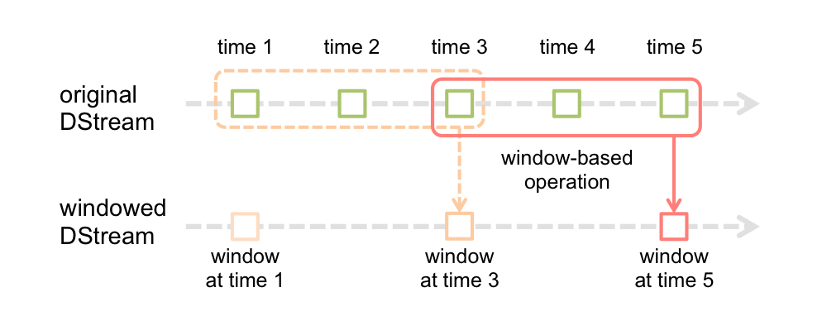
Window Operations
Windowed computations apply transformations over a sliding window of data
The window slides over a source DStream and combines the RDDs that fall within the window
Notes:
sliding window: σταθερού μήκους χρονικό διάστημα που κινείται συνεχώς στον χρόνο.

Slide 130
Window Operations
Any window operation needs to specify two parameters:
window length - The duration of the window (3 in the figure).
sliding interval - The interval at which the window operation is performed (2 in the figure).

Slide 131
Checkpoint
Apache spark
provides the core functionality
MLlib
a number of machine learning algorithms
GraphX
algorithms for graph analytics
SQL
computation over structured data
Streams
processing over streaming data

Slide 132
Discussion

Slide 133
Acknowledgments - Resources
Aaron Davidson – Building a unified data pipeline in apache spark
Madhukara Phatak - Anatomy of RDD
Anton Kirillov - Apache spark in depth – Core concepts, architecture & internals
Patrick Wendell – Tuning and Debugging in Apache Spark

Slide 134
Acknowledgments - Resources
Spark – Devops advanced class
Spark Shuffle Introduction
Pietro Michiardi - Apache Spark Internals
Databricks – Advanced Spark
GraphX: Graph Processing in a Distributed Dataflow Framework

Slide 135

Vangelis Kritsotakis & Panagiotis Papadakos
Information Systems Laboratory
ICS FORTH

Slide 136
Spark Applications: The Big Picture
Driver Program
SparkContext
Cluster Manager
Worker Node₁
Worker Node₂
Worker Node₃
Worker Node₄
Executor
Executor
Executor
Executor
Executor
Executor
Executor
Executor
Apache Spark Cluster
Executor
Executor
Executor
Executor
Cache
Cache
Cache
Cache
Cache
Cache
Cache
Cache
Cache
Cache
Cache
Cache
Task
Task
Task
Task
Task
Task
Task
Task
Task
Task
Task
Task
Task
Task
Task
Task
Task
Task
Task
Task
Task
Task
Task
Task
Task
Task
Task
Task
Task
Task
Task
Task
Task
Task
Task
Task
Task
Task
Task
Task
Task
Task
Task
Task
Task
Task
Task
Task
File
Data Node₁
Data Node₂
Data Node₃
Data Node₄
HDFS Cluster
A
A
C
B
C
A
B
A
B
B
D
D
D
C
C
D

Slide 137
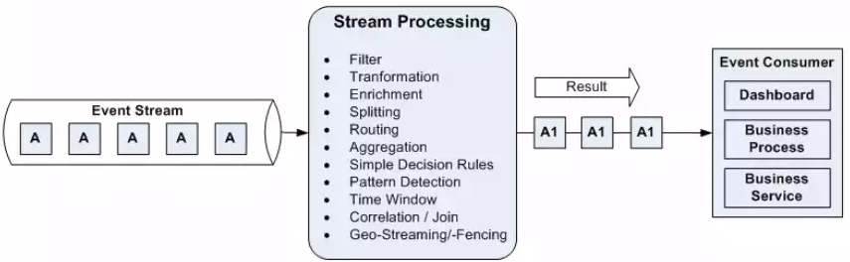
Stream Processing
Infrastructure for continuous data processing
Computational model can be as general as MapReduce but with the ability to produce low-latency results
Data collected continuously is naturally processed continuously

Slide 138
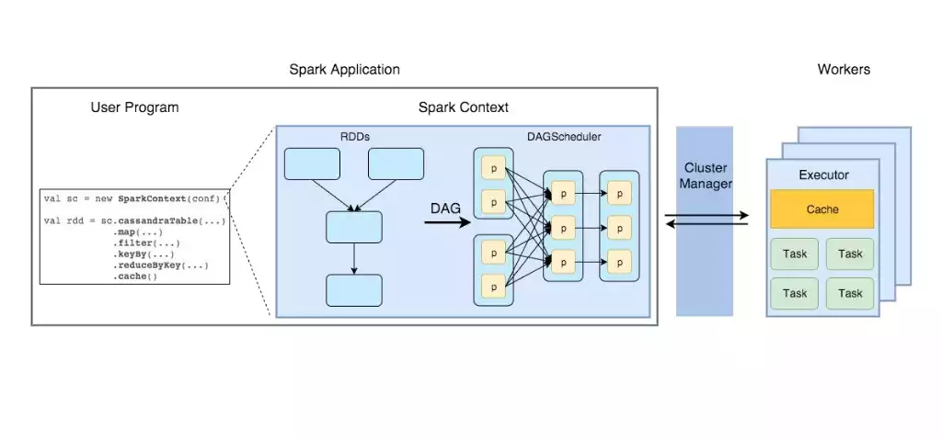
Core concepts

Slide 139
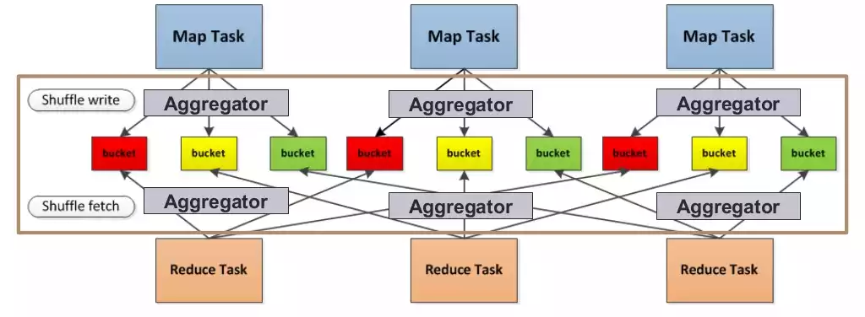
Shuffle
Diagram from Spark Shuffle Introduction

Slide 140
Explicitly store RDDs in memory, on disk or off-heap (cache, persist)
Checking for truncating RDD lineage

Slide 141
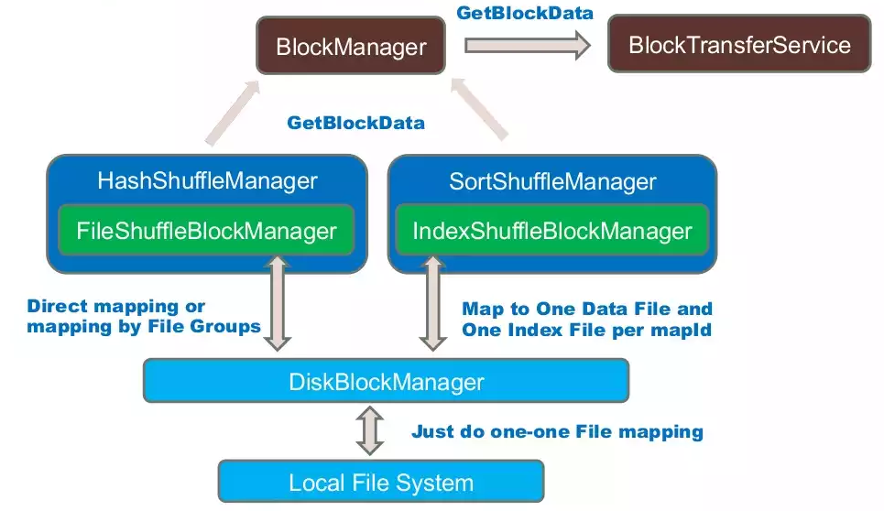
High Level Data Flow
Diagram from Spark Shuffle Introduction

Slide 142
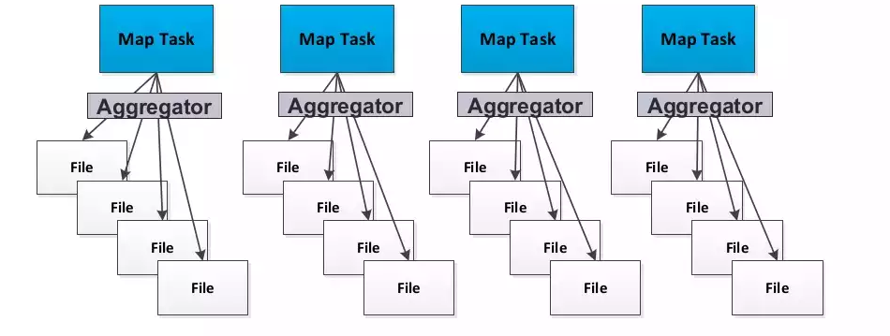
Hash-Based Shuffle – Writer
Basic Shuffle Writer
Each bucket mapped to a single file
Diagram from Spark Shuffle Introduction

Slide 143
Hash-Based Shuffle – Writer
Basic Shuffle Writer
M * R shuffle spill files
Concurrent C * R opened shuffle files
If shuffle spill enabled, can generate more tmp spill files
Consolidate Shuffle Writer
Reduce the total spilled files in C * R (if M >> C)
Concurrent opened is the same as before
Memory Consumption
C * R + N file handlers
Each file handler could take up to 32KB~100KB+ memory for various buffers

Slide 144
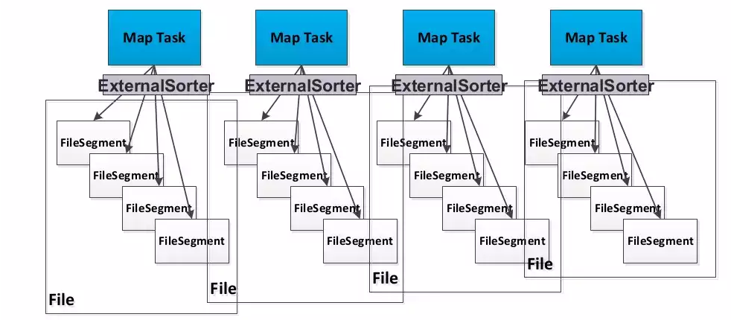
Sort-based shuffle – Shuffle Writer
Sort Shuffle Writer
Diagram from Spark Shuffle Introduction

Slide 145
Sort-Based Shuffle – Shuffle Writer
Each map task generates 1 shuffle data file + 1 index file
Utilize ExternalSorter to do the sort
If map-side combine is required, data will be sorted by key and partition for aggregation
Otherwise data will only be sorted by partition
If reducer number <= 200 and no need to do aggregation or ordering, data will not be sorted at all
Use hash way and spill to separate files for each reduce partition, then merge them into one per map for final output

Slide 146
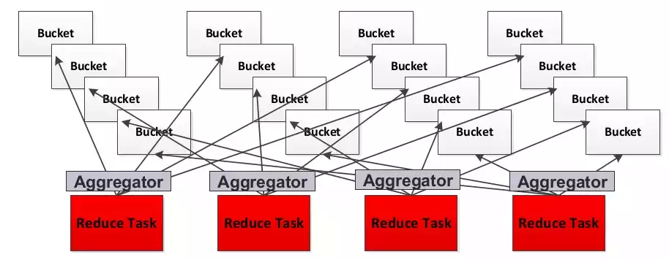
Hash-Based Shuffle – Reader
Actually at present, Sort Based Shuffle also uses HashShuffleReader
Diagram from Spark Shuffle Introduction

Slide 147
Related Conceptions
BlockTransferService
Provide a general interface for ShuffleFetcher and working with BlockDataManager to get local data
ShuffleClient
Wrap up fetchin data process for the client side, say setup TransportContext, fetchin data process for the client side, say setup TransportContext, fetchin data process for the client side, say setup TransportContext, TransportClient
TransportContext
Context to setup the transport layer
TransportServer
Low-level streaming service server
TransportClient
Client for fetching consecutive chunks from TransportServer

Slide 148
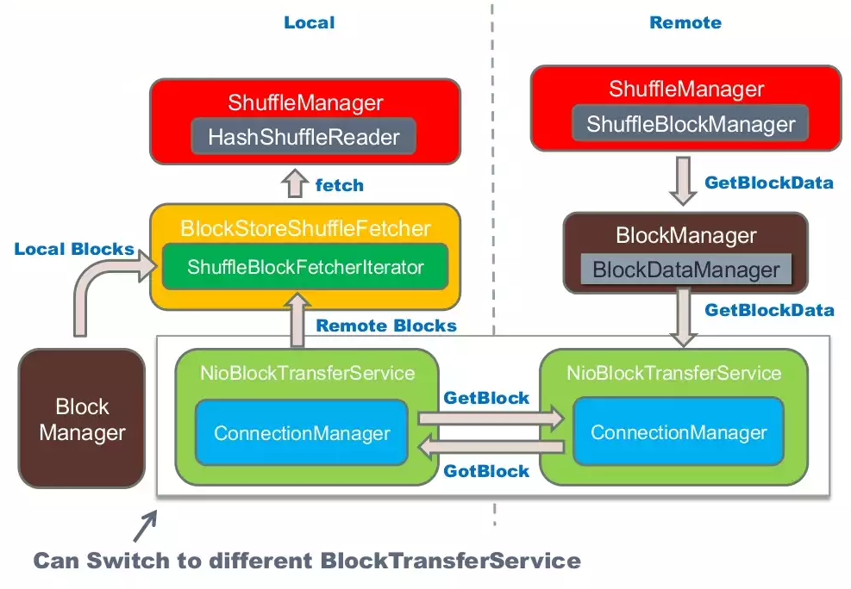
Data Flow
Diagram from Spark Shuffle Introduction

Slide 149
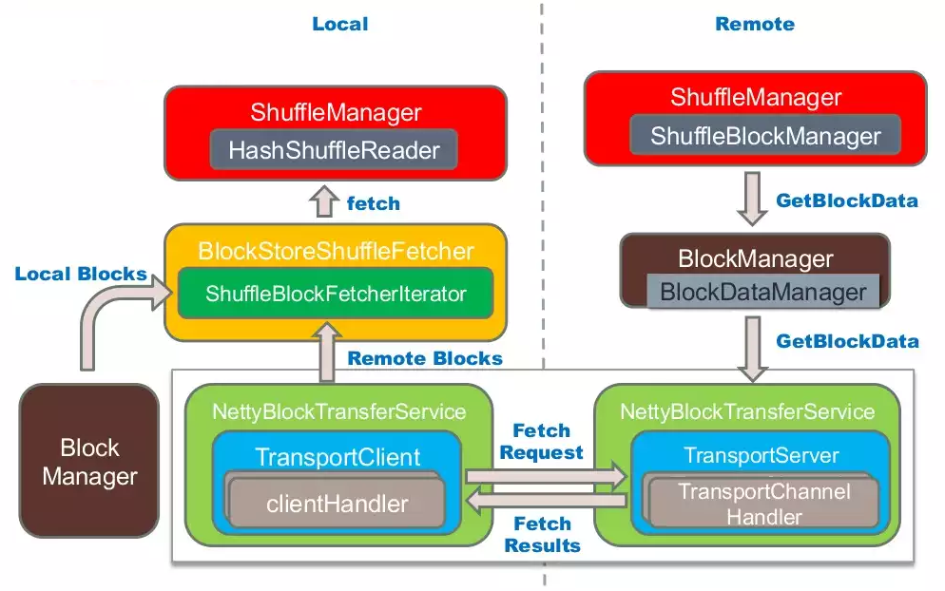
Data Flow
Diagram from Spark Shuffle Introduction

Slide 150
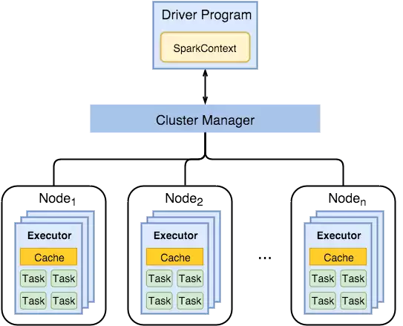
Spark Applications: The Big Picture
Spark Driver
Separate process to execute user application
Creates SparkContext to schedule jobs execution and negotiate with cluster manager
Executors
Run tasks scheduled by driver
Store computation results in memory, on disk or off-heap
Interact with storage systems
Cluster Manager
Mesos
Yarn
Spark standalone

Slide 151
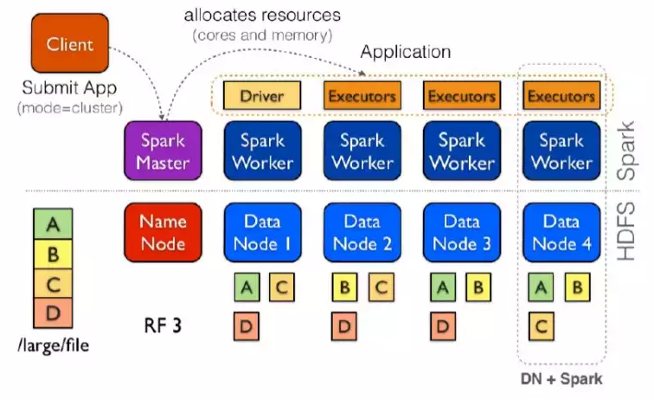
(ADD TO NEXT SLIDE) Spark Applications: The Big Picture
Data locality principle
Same as Hadoop MapReduce
Avoid network I/O, workers should manage local data
Data locality and caching
When loading data from HDFS so use HDFS locality prefs (blocks)
If RDD is in cache use its locations
If something fails out of cache go back to HDFS
Notes:
Diagram from Introduction to Spark Internals

Slide 152
RDDs: A developer’s view
Distributed immutable data + lazily evaluated operations
partitioned data
transformations & actions
An interface defining 5 main properties
getPartitions - list of partitions (splits)
getDependencies - list of dependencies on other RDDs
compute - function for computing each split
getPrefferedLocations - list of preferred locations to compute each split on
partitioner - partitioner for key-value RDDs

Slide 153
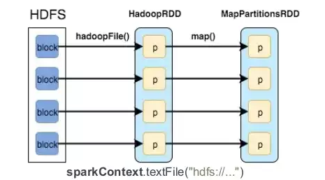
RDDs Example
http://datastrophic.io/core-concepts-architecture-and-internals-of-apache-spark/
HadoopRDD
getPartitions – HDFS blocks
getDependencies - None
compute – load block in memory
getPrefferedLocations – HDFS block locations
partitioner - None
MapPartitionsRDD
getPartitions – same as parent
getDependencies – parent RDD
compute – compute parent and apply map
getPrefferedLocations – same as parent
partitioner - None

Slide 154
Joined RDD
getPartitions – one per reduce task
getDependencies – shuffle on each parent
compute – read and join shuffled data
getPrefferedLocations – none
partitioner - HashPartitioner(numTasks)

Slide 155
Window Operations - Example
Assume that we have DStream of (word, 1) pairs.
In order to reduce last 30 seconds of data, every 10 seconds we can use the operation:
reduceByKeyAndWindow(reduceFunc: (V, V) ⇒ V, windowLength, slideInterval, (optional)numPartitions: Int)
val windowedWordCounts = pairs.reduceByKeyAndWindow((a:Int,b:Int) => (a + b), Seconds(30), Seconds(10))
Notes:
Example where we compute the last 30 secs of data every 10 secs

Slide 156
Other Window Operations
There are other similar window operations:
countByWindow(windowLength, slideInterval) Returns a sliding window count of elements in the stream.
reduceByWindow(reduceFunc: (V, V) ⇒ V, windowLength, slideInterval) Returns a new single-element stream, created by aggregating elements in the stream over a sliding interval using reduceFunc.
countByValueAndWindow(windowLength, slideInterval, numPartitions: Int]) When called on a DStream of (K, V) pairs, returns a new DStream of (K, Long) pairs where the value of each key is its frequency within a sliding window.

Slide 157
Stream Join Operations
Join can be applied as you imagine:
Example 1:
val stream1: DStream[String, String] = ...
val stream2: DStream[String, String] = ...
val joinedStream = stream1.join(stream2)

Slide 158
Stream Output Operations
Some common output operations:
print() Prints the first ten elements of every batch of data in a DStream on the driver node running the streaming application.
saveAsTextFiles(prefix, [suffix]) Save this DStream's contents as text files. The file name at each batch interval is generated based on prefix and suffix: “prefix-TIME_IN_MS[.suffix]”.
foreachRDD(func) Applies a function, func, to each RDD generated from the stream.

Slide 159
RDD Dependency Types → Optimizations
The DAG scheduler optimizes stages and tasks before submitting to the task scheduler
Pipelining narrow dependencies within a stage
Picks join algorithms based on partitioning and trying to minimize shuffles
https://stanford.edu/~rezab/classes/cme323/S15/slides/devops_slides.pdf

Slide 160

Hadoop – No unified vision
Sparse modules
Diversity of APIs
Higher operational costs

